Slide 1
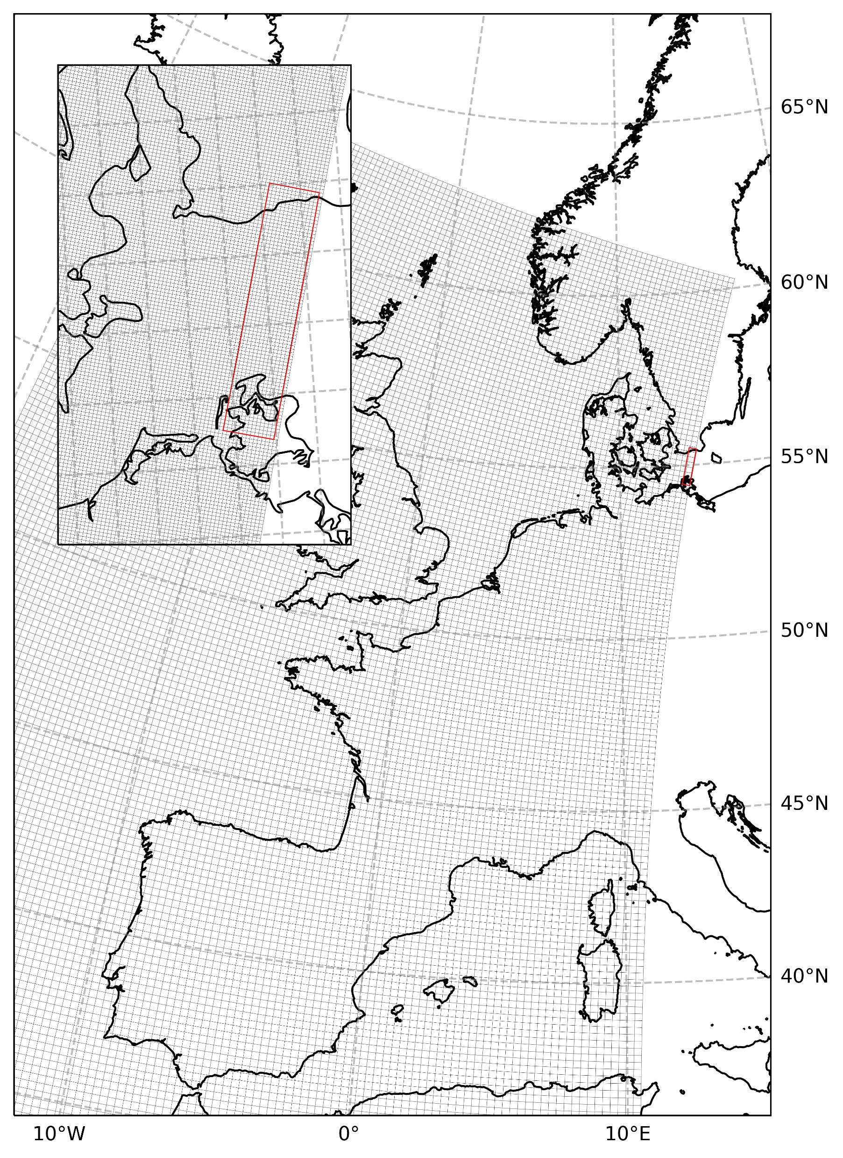
CMEMS Baltic LBC For NEATL36 Configuration

Slide 2
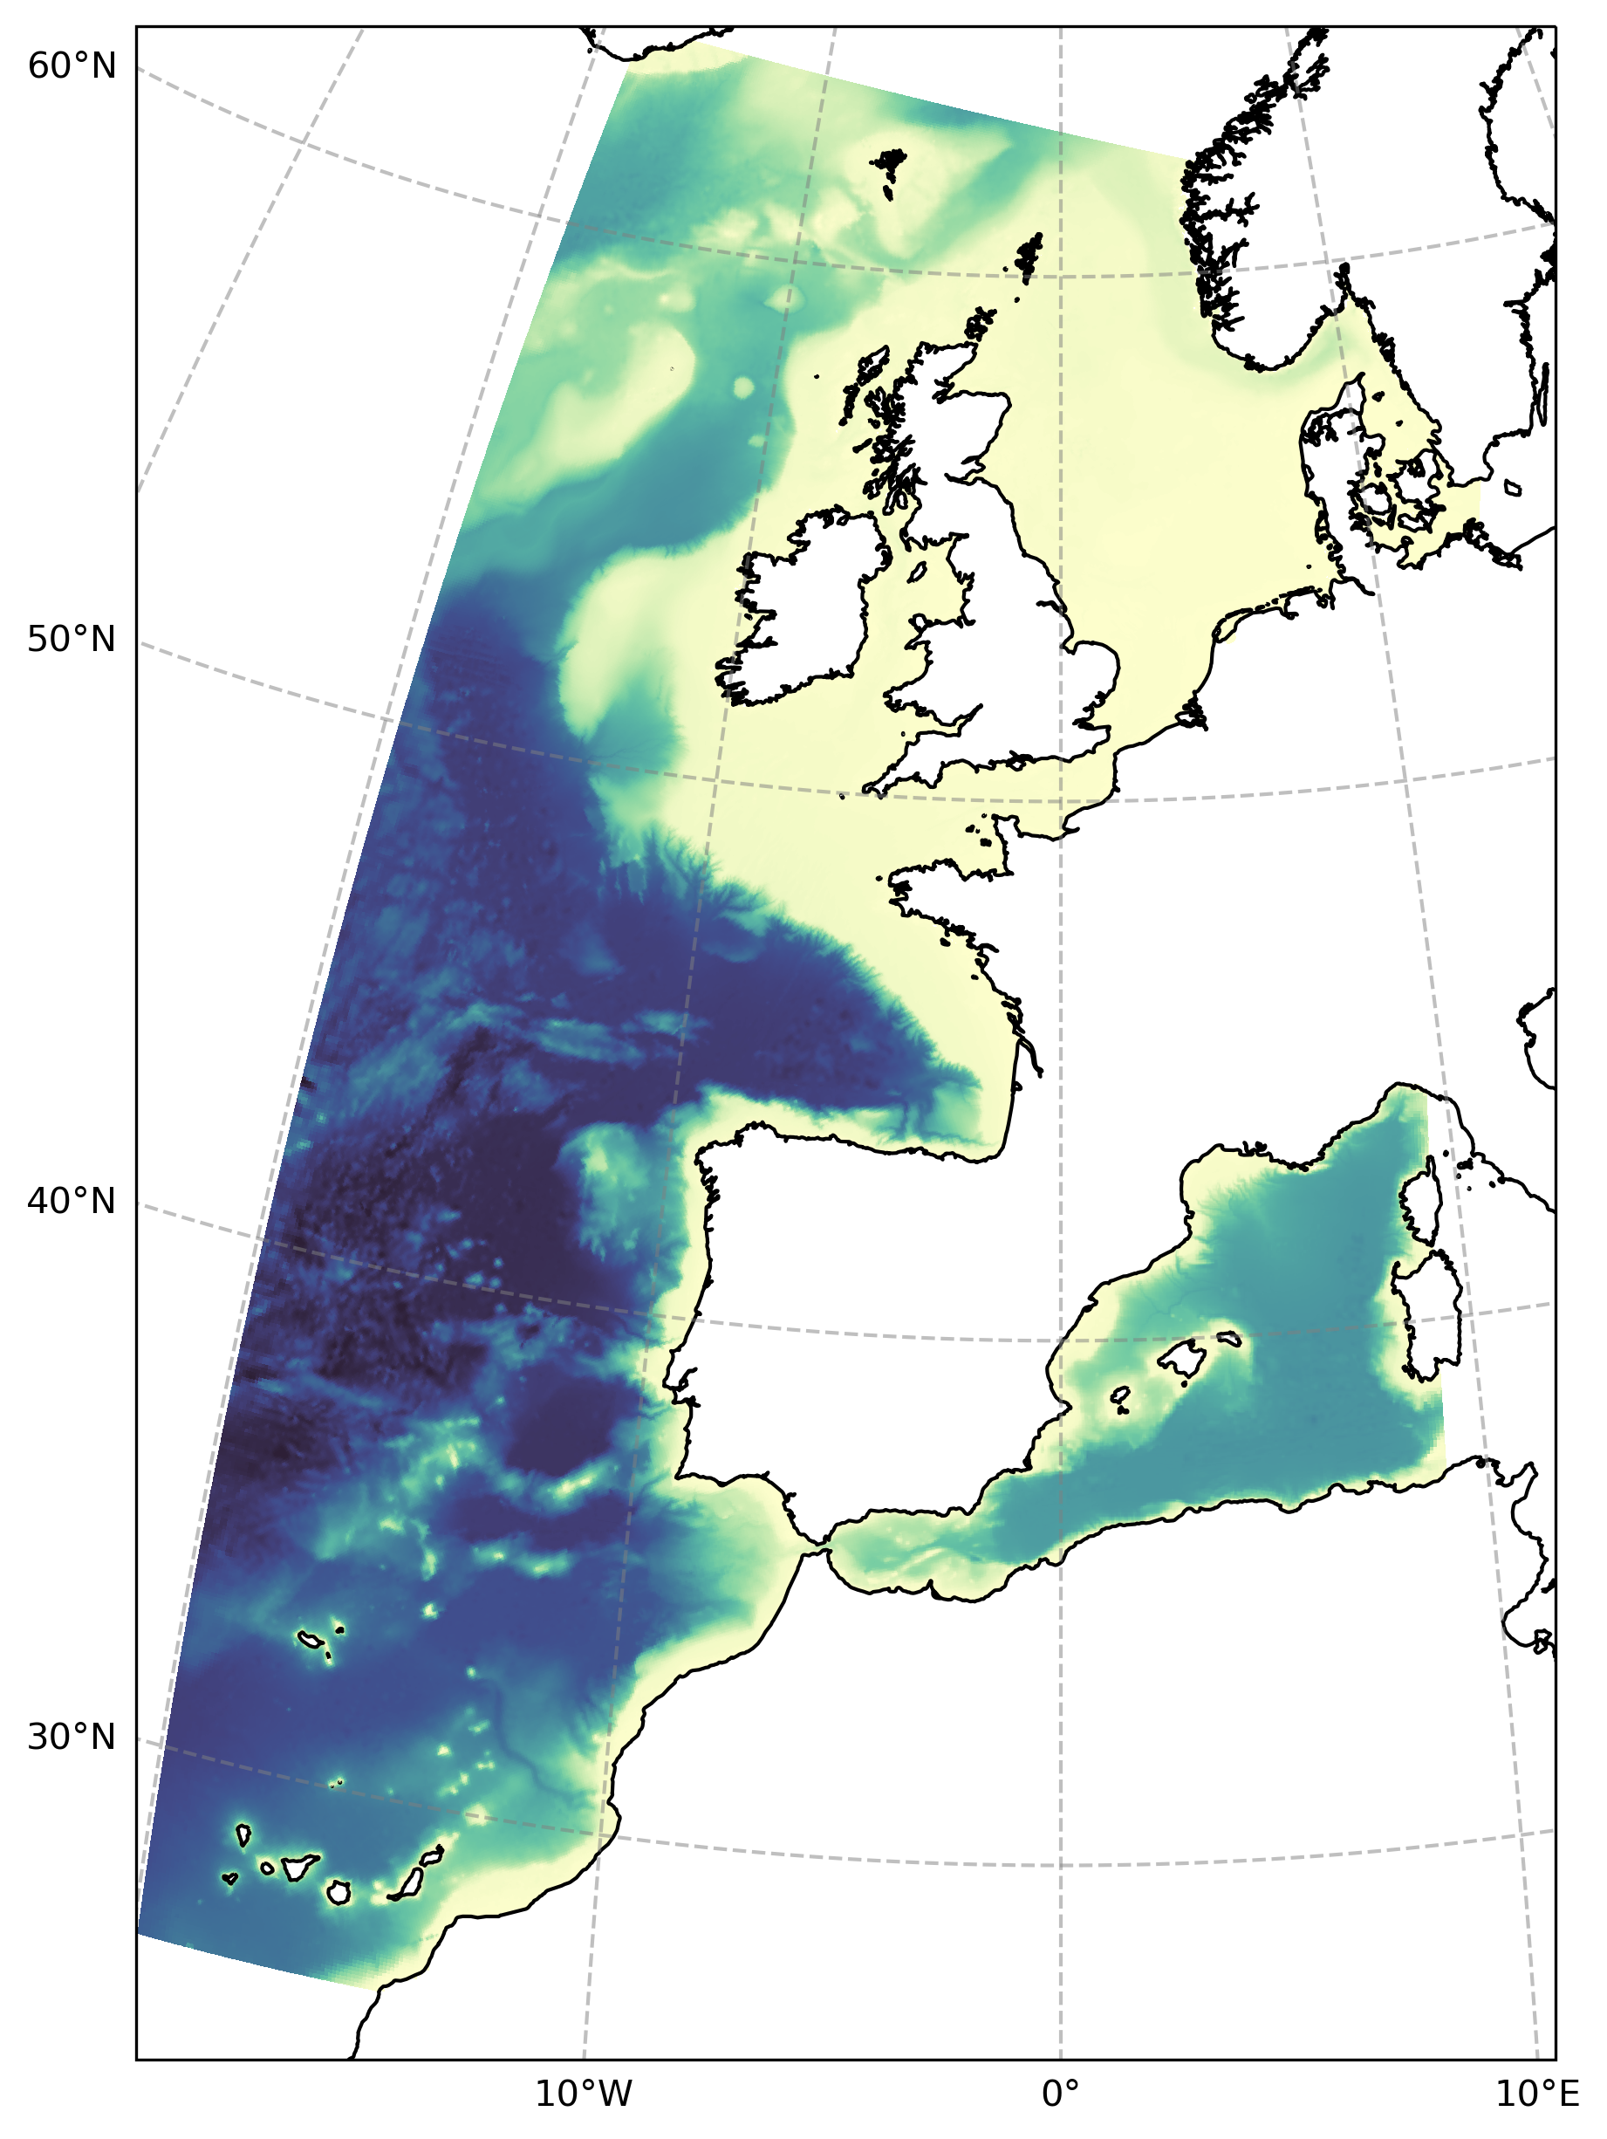
Summary
Arkona Basin
Glo12+Fes2014
Glo12+Fes2014
Glo12+Fes2014
BAL-CMEMS+FES2014
Glo12+Fes2014
Glo12+Fes2014

Slide 3
Context
Put some climatologies (seasonal temperature, currents...)
T-S plots
Some literature
Is BALMFC a Good candidate to replace GLO at east2 boundary?

Slide 4
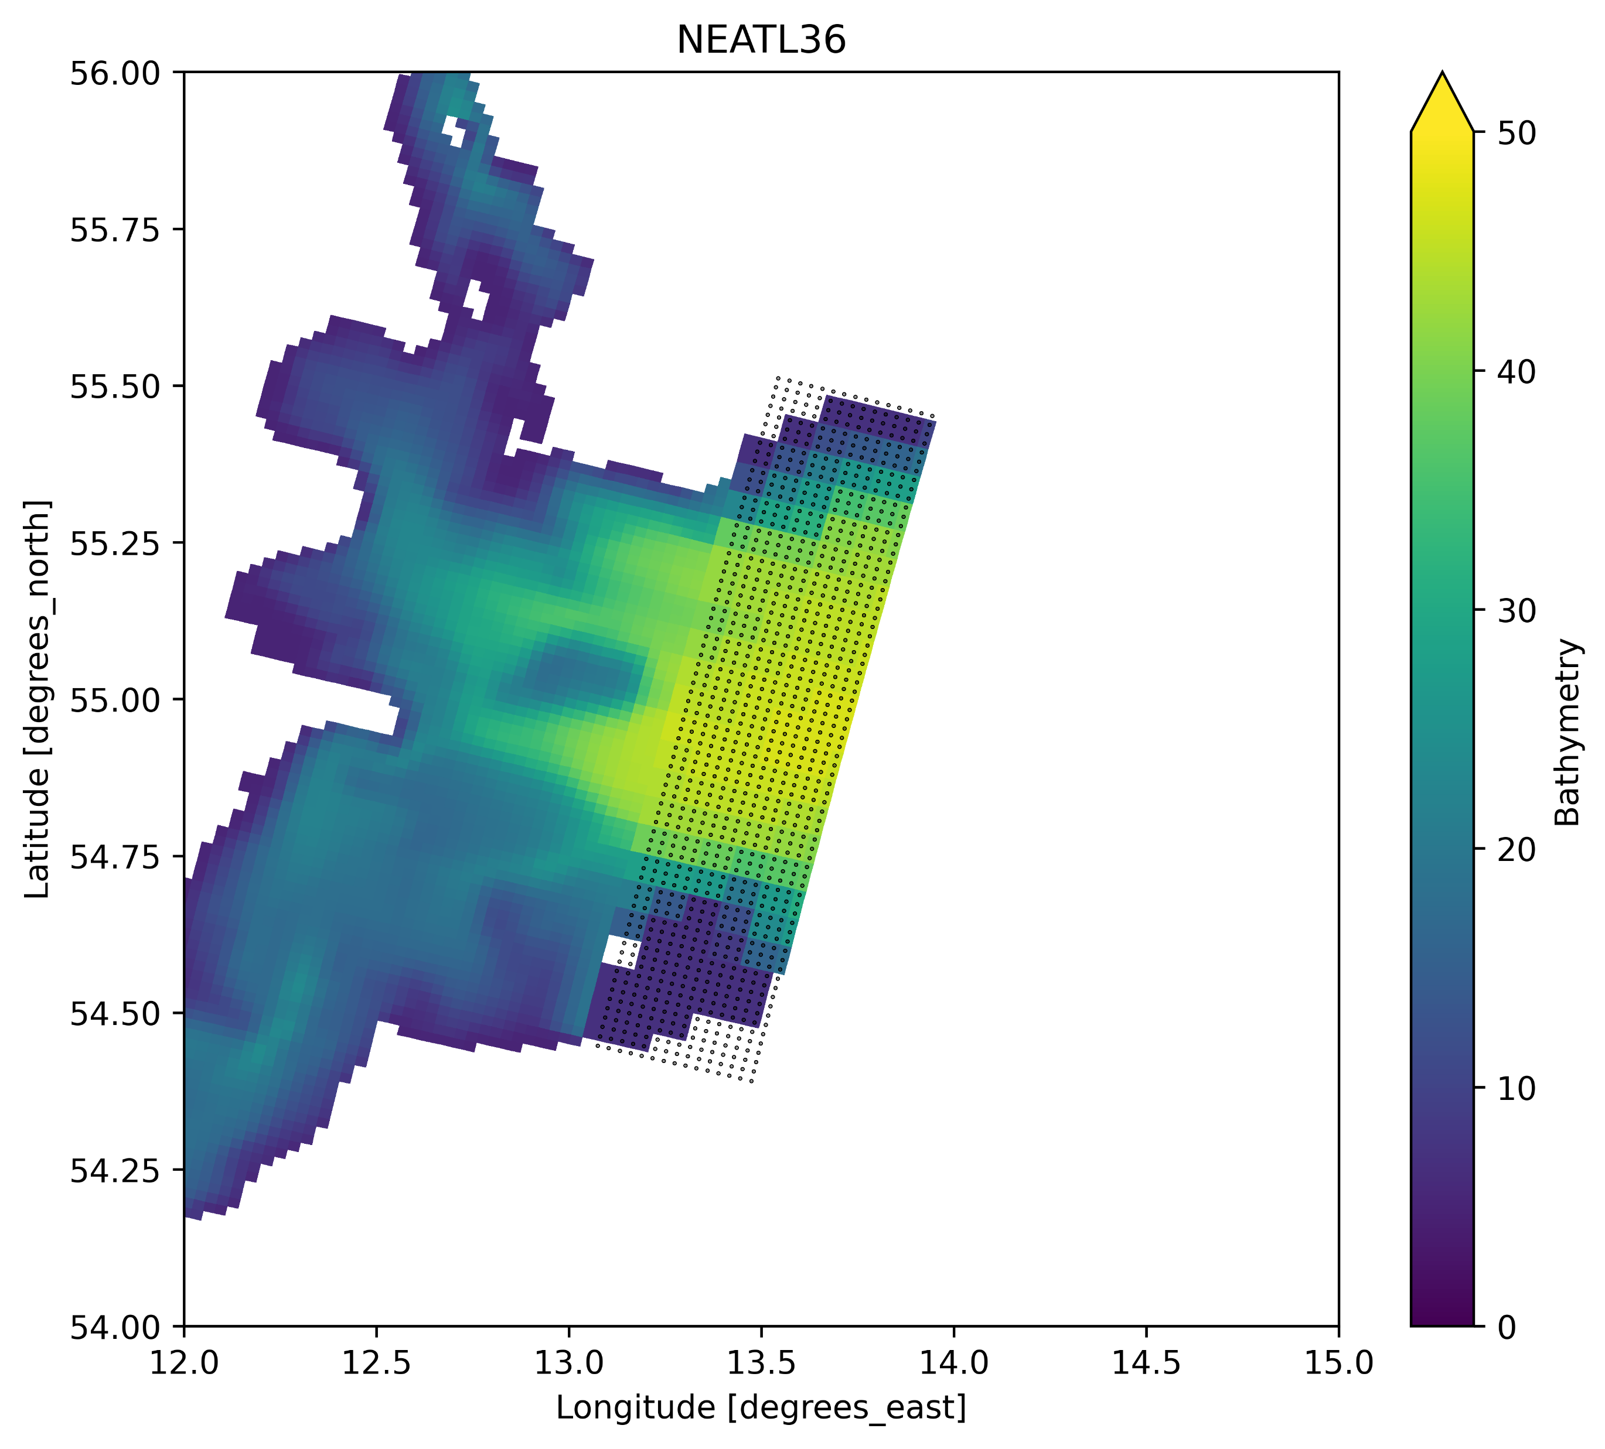
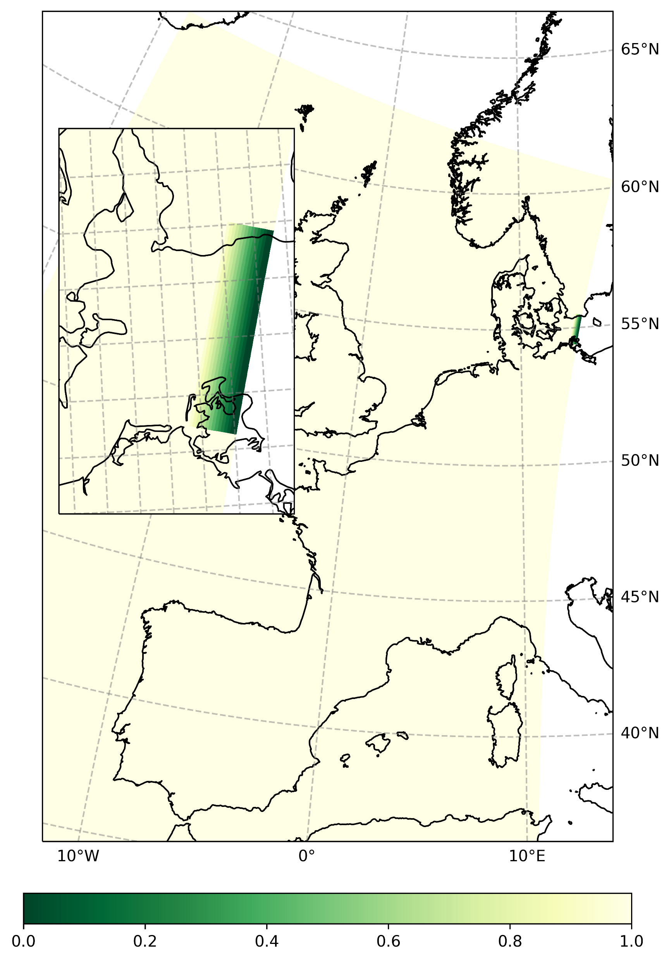
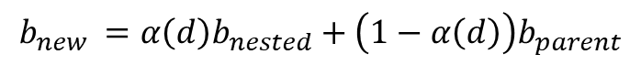
Bathymetry Relaxation
Open boundary puts into communication models with different configuration, resulting into a discontinuity at any rate.
GEBCO bathymetry information is used in both NEATL36 and BALMFC configurations that operate on different meshes though.
In the case IBI (nested in GLO12), the bathymetry of the relaxation areas of open boundaries is clamped to the parent model (fig up-right).
To make the NEATL36 – BALMFC smooth the bathymetry can be relaxed to parent model with a linear function
$$b_{new }=α\left(d\right)b_{nested}+\left(1−α\left(d\right)\right)b_{parent}$$
Where d is the distance from the boundary and α is a linear function of d (fig. down-right)

Slide 5
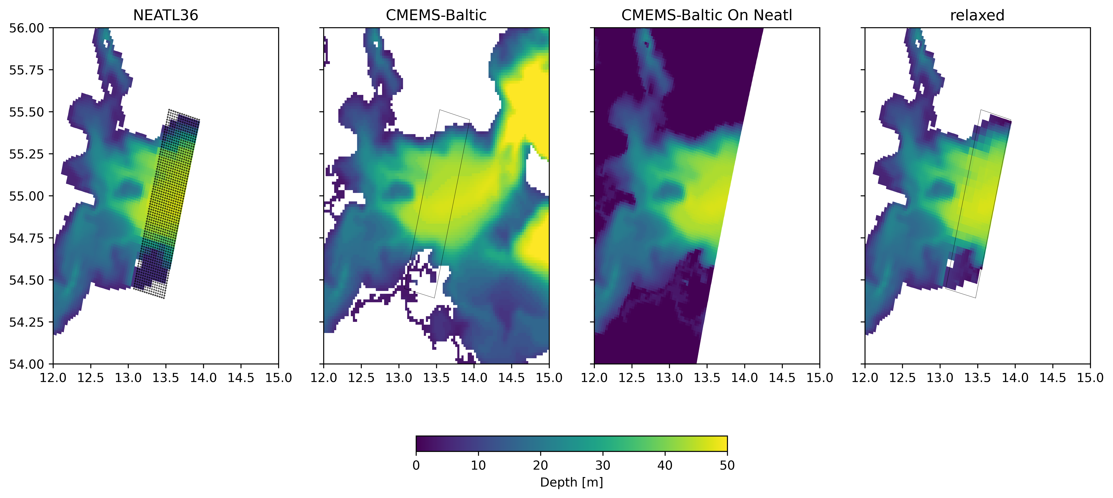
Bathymetry Relaxation
T-mask is preserved

Slide 6
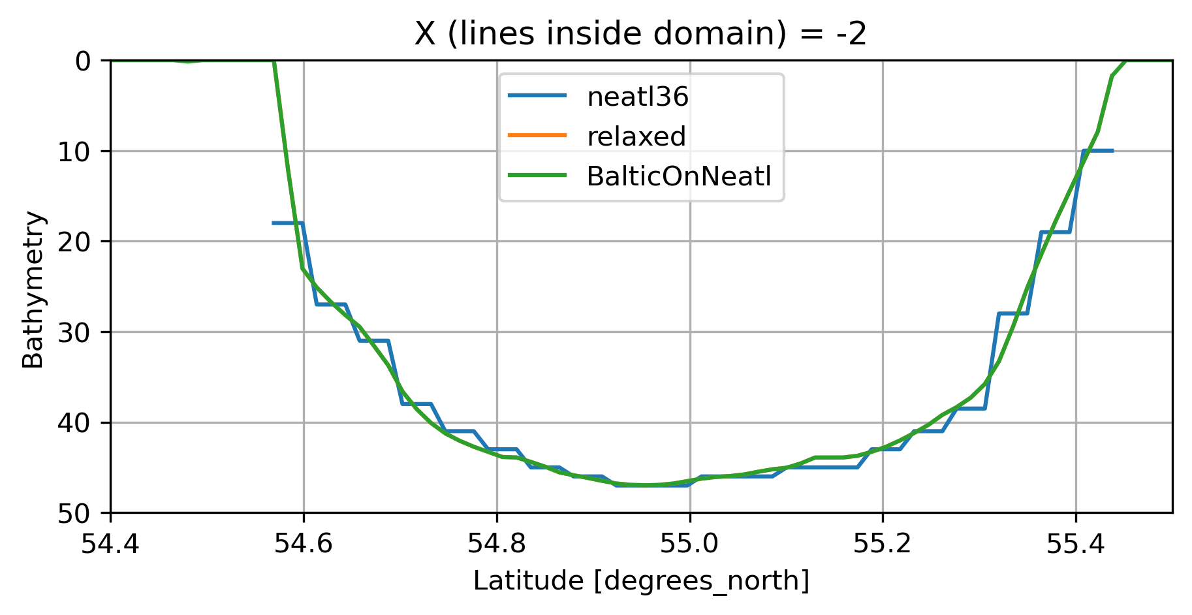
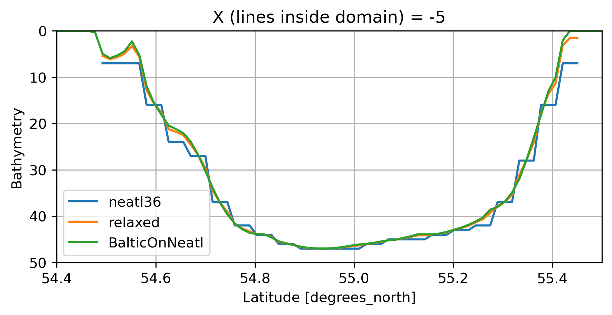
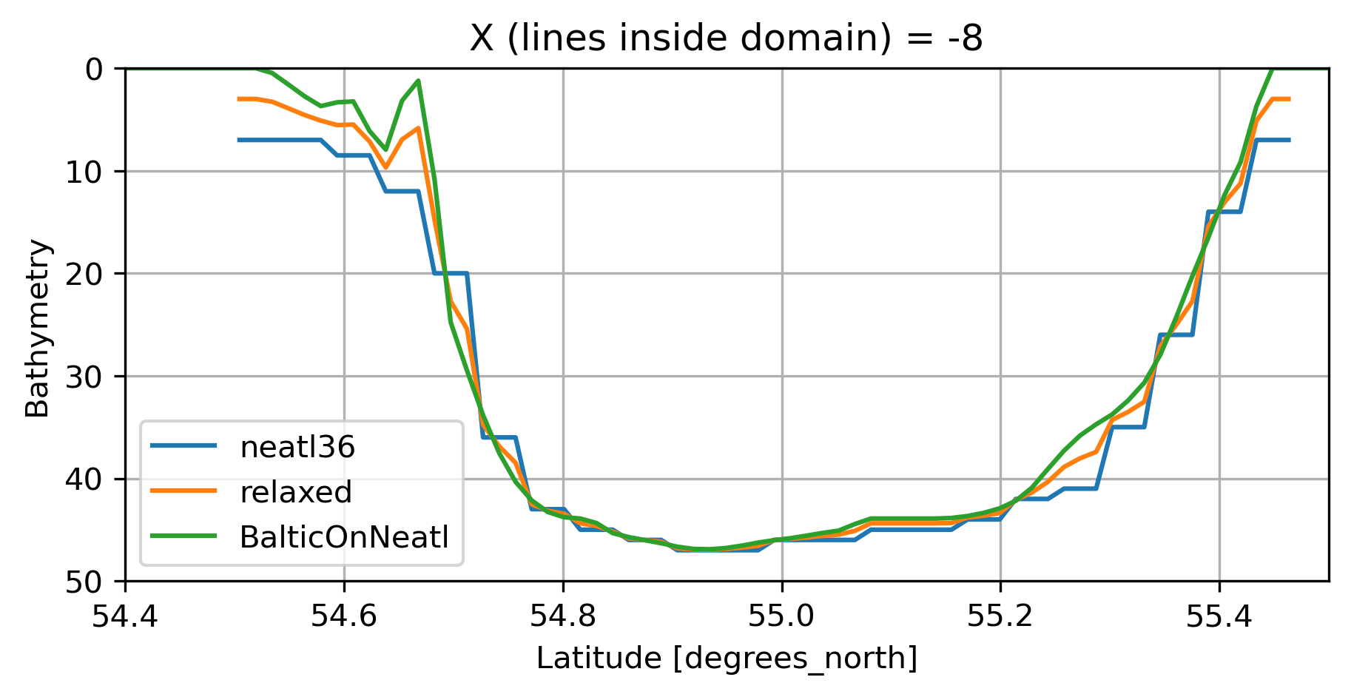
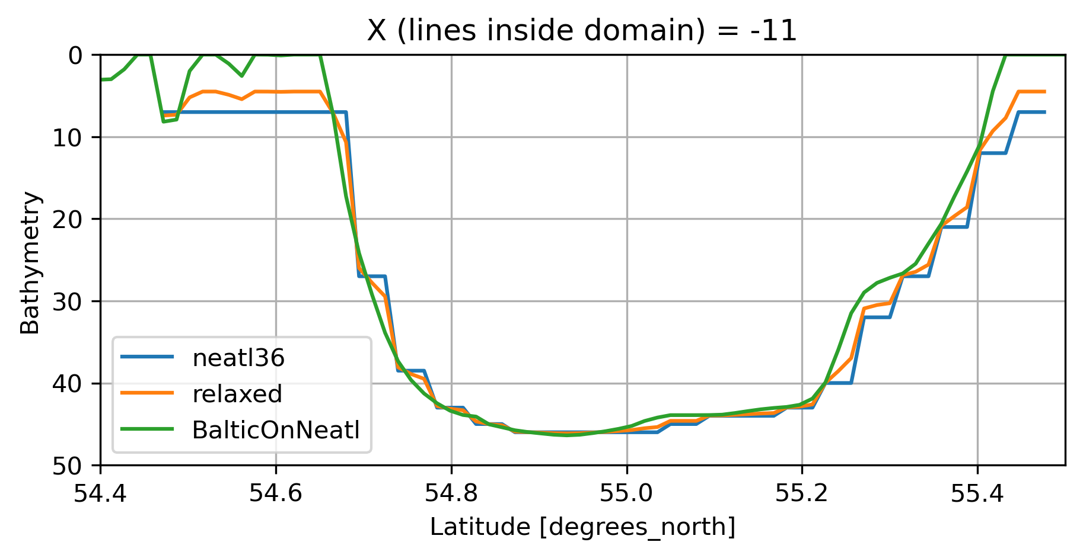
Bathymetry Relaxation

Slide 7
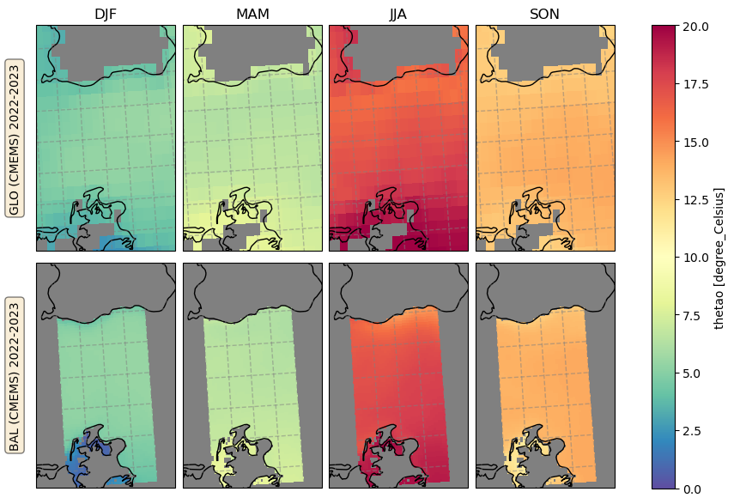
Context

Slide 8
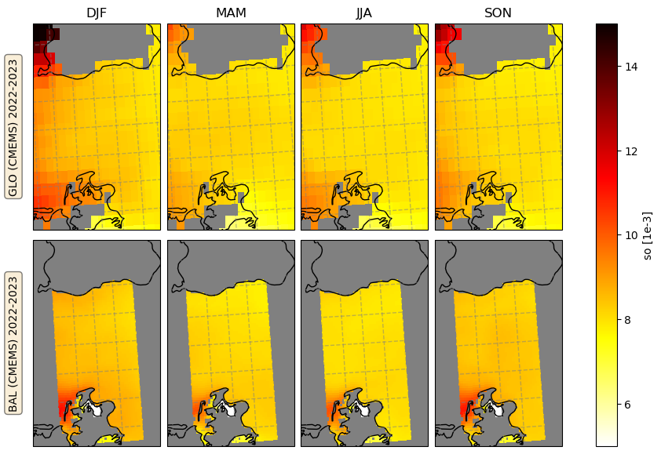
Context

Slide 9
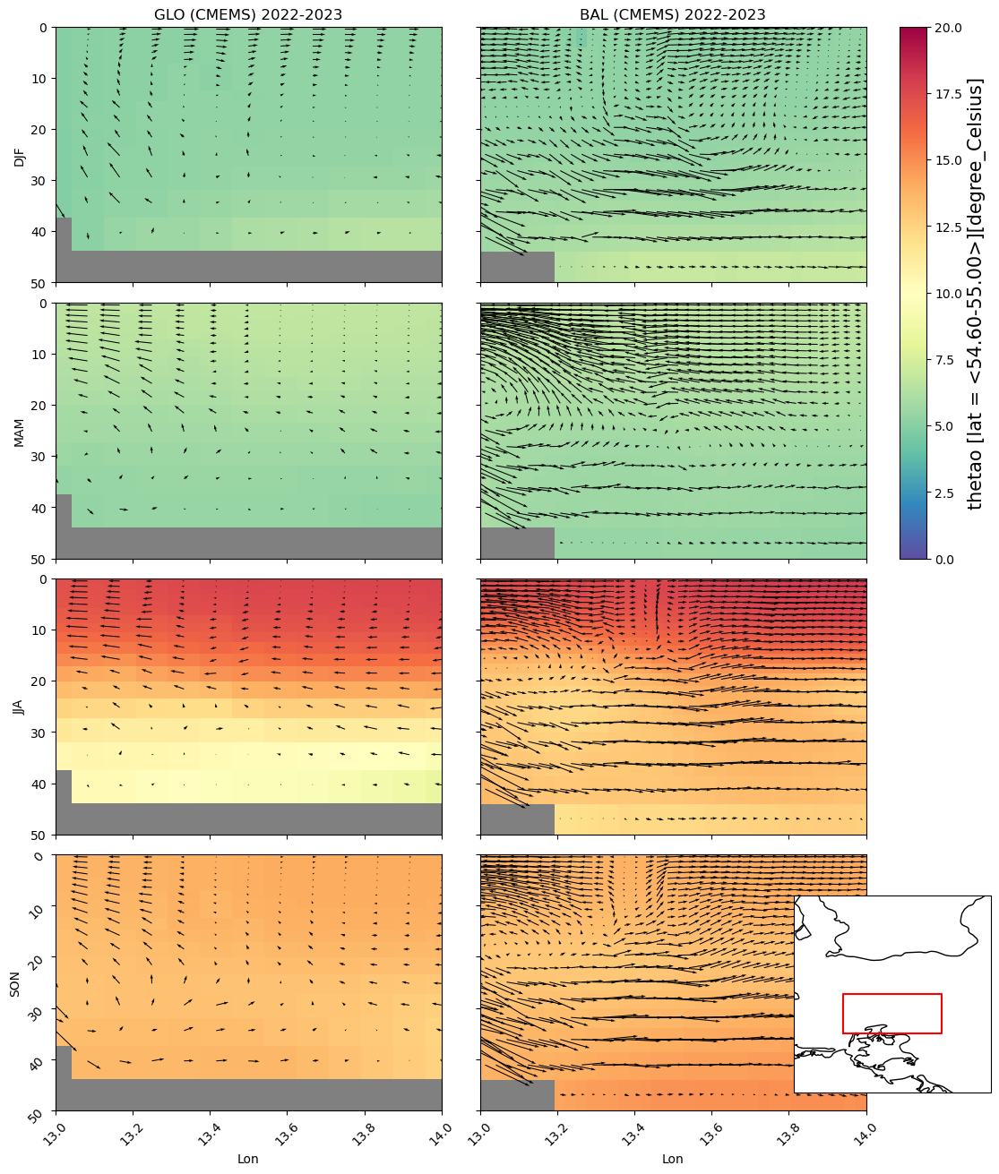
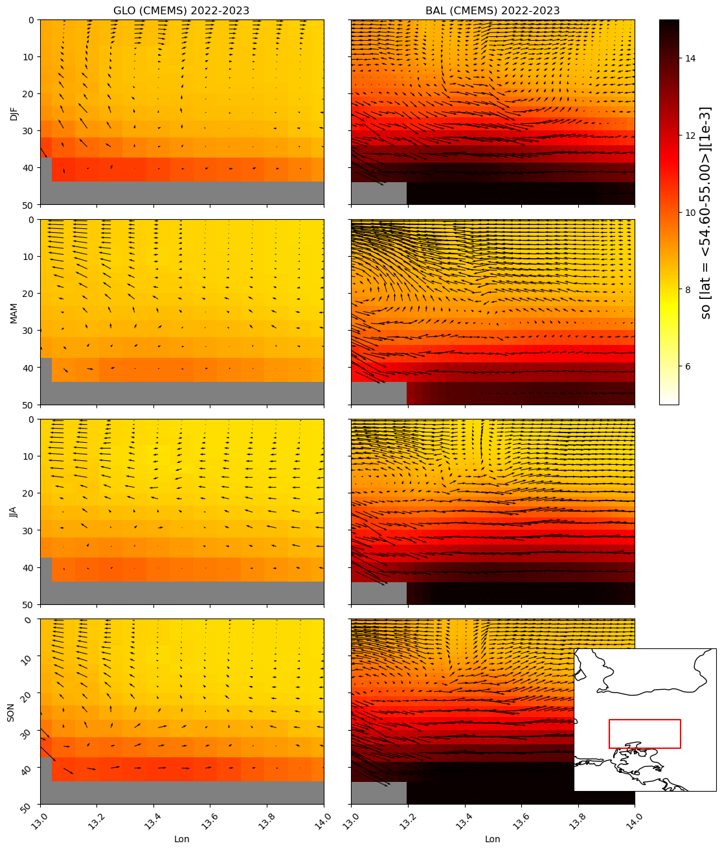
Context
Lat average
w*1000

Slide 10
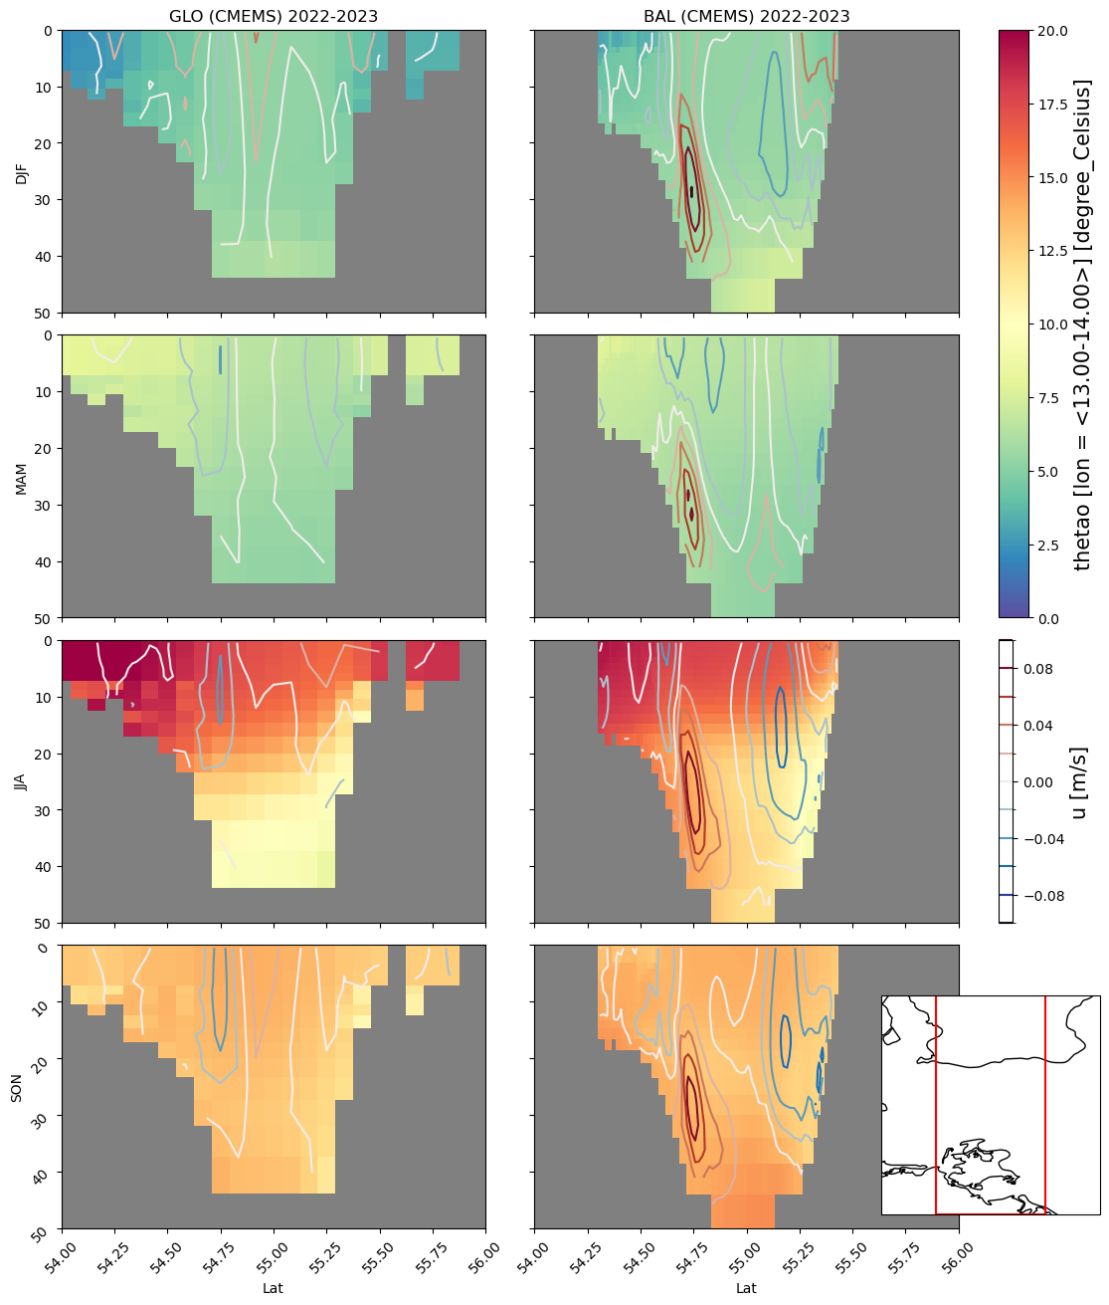
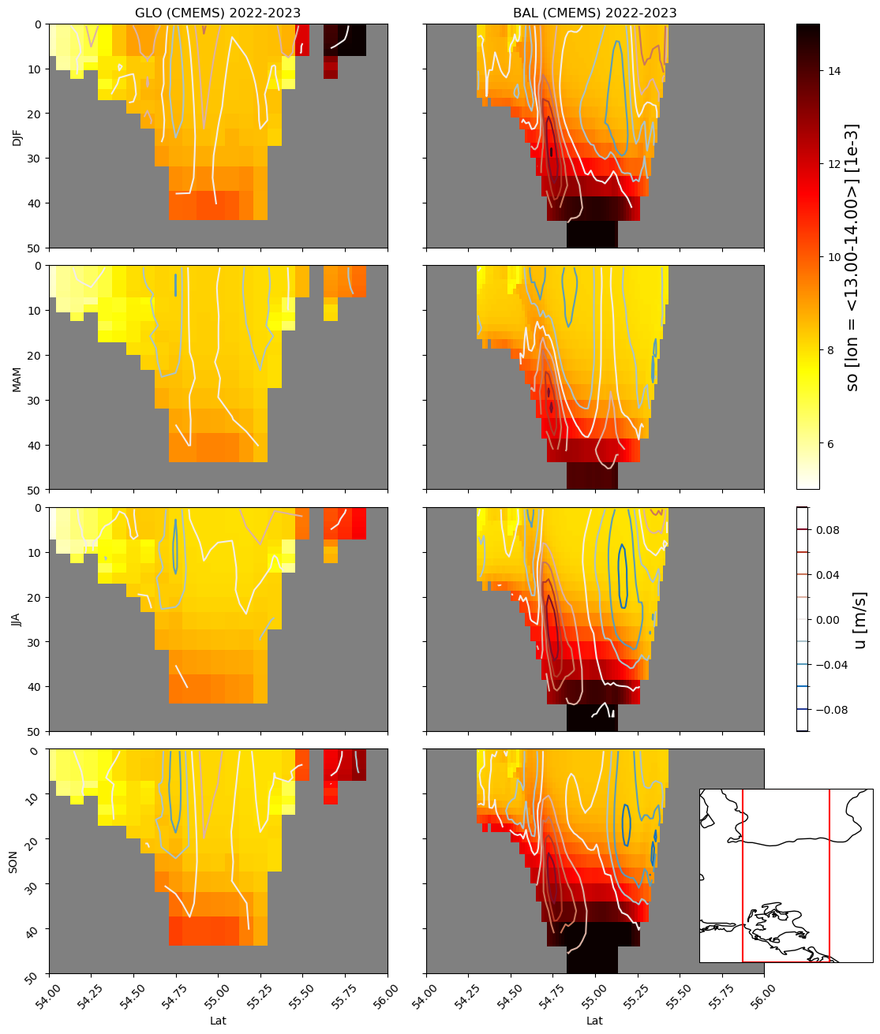
Context
Lon average

Slide 11
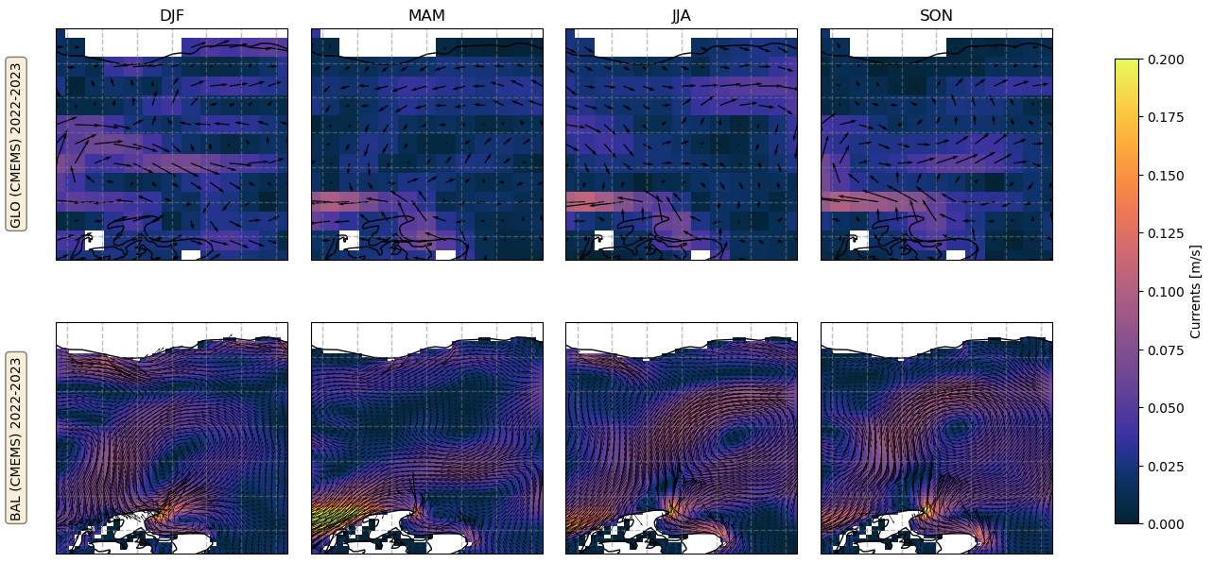
Context
Circulation

Slide 12
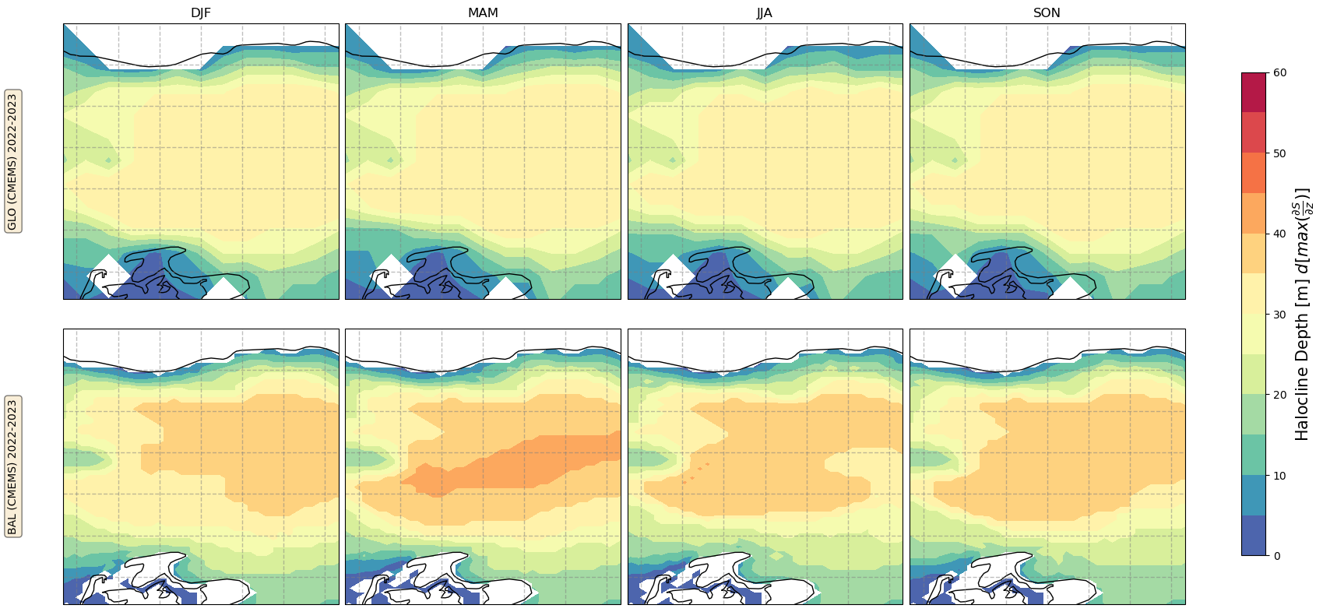
Context
Stratification
Bal Halocline Depth closer to literature [Meier,2007] (~40m)

Slide 13
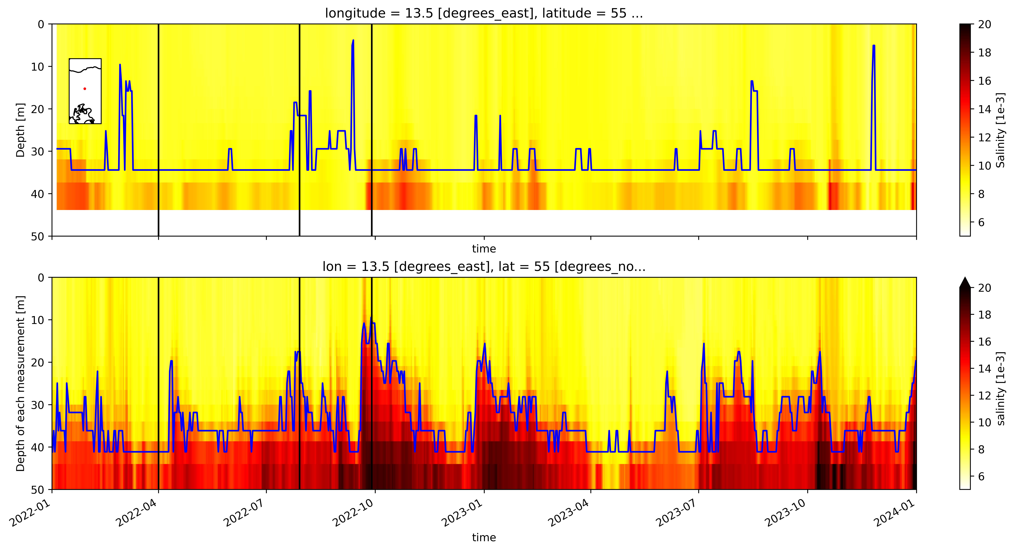
Context
Stratification
Halocline = max(ds/dz)

Slide 14
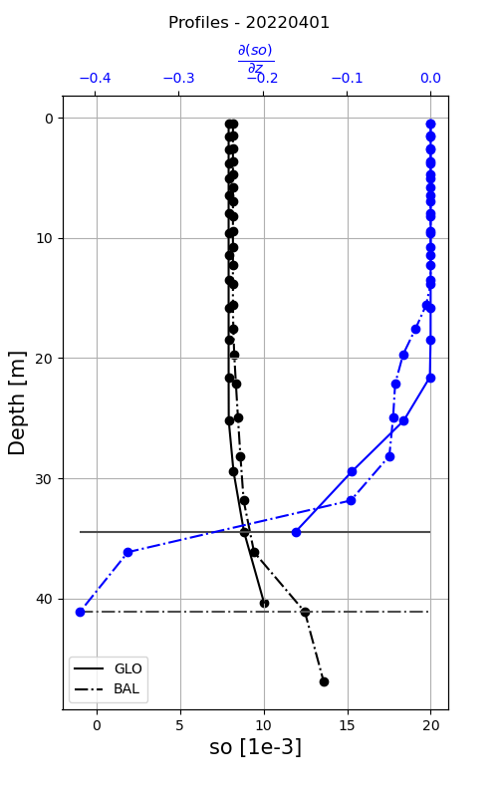
Context
Stratification

Slide 15
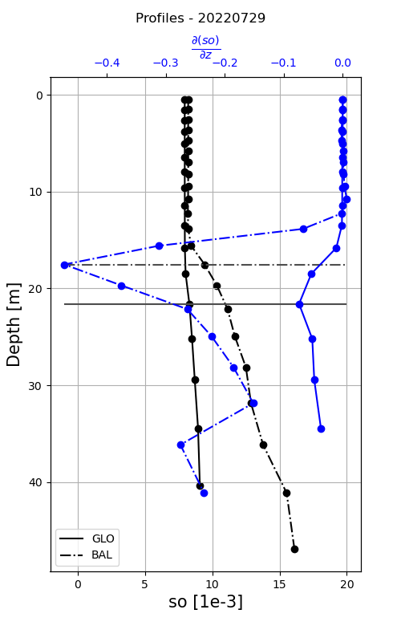
Context
Stratification

Slide 16
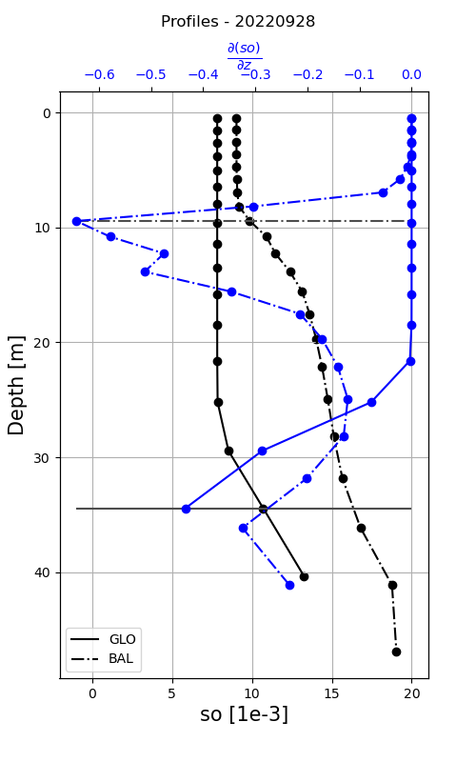
Context
Stratification

Slide 17
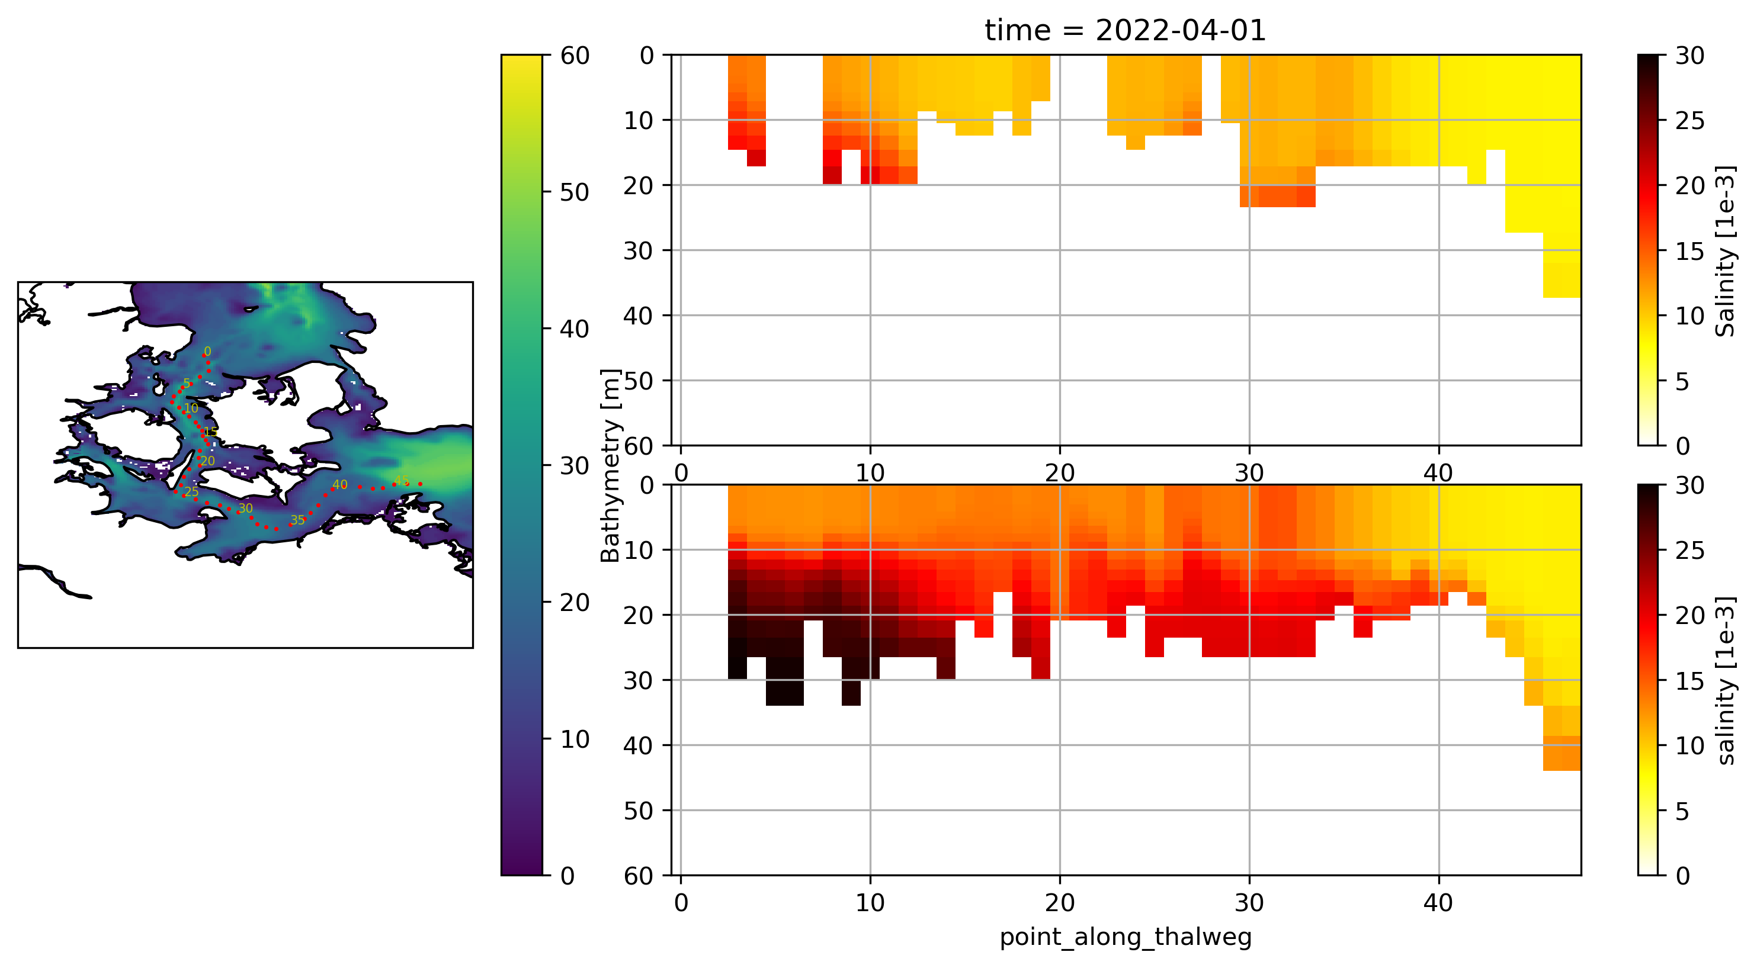
Context
Stratification

Slide 18
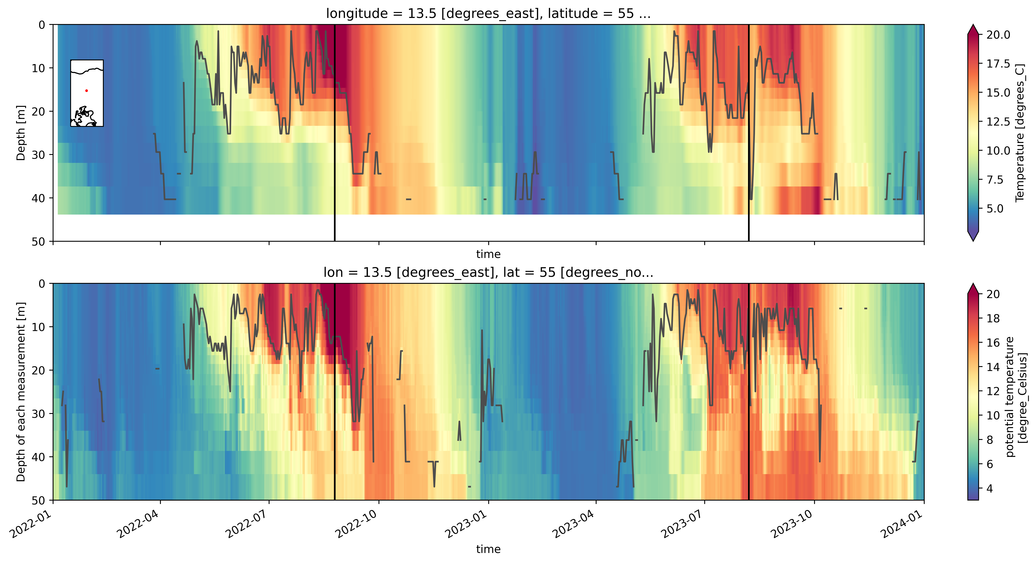
Context
Stratification
MLD = dT > 0.2 [deBoyer Montegut,2004]

Slide 19
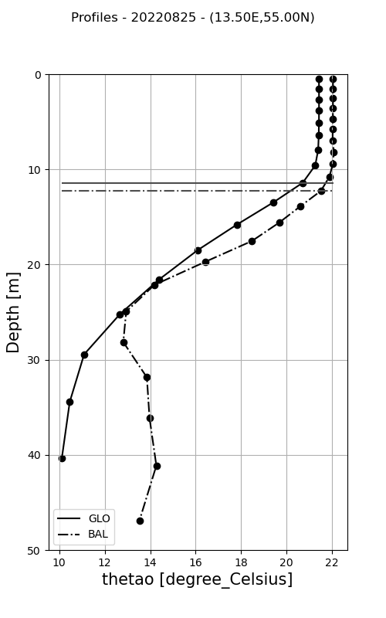
Context
Stratification
MLD = dT > 0.2 [deBoyer Montegut,2004]

Slide 20
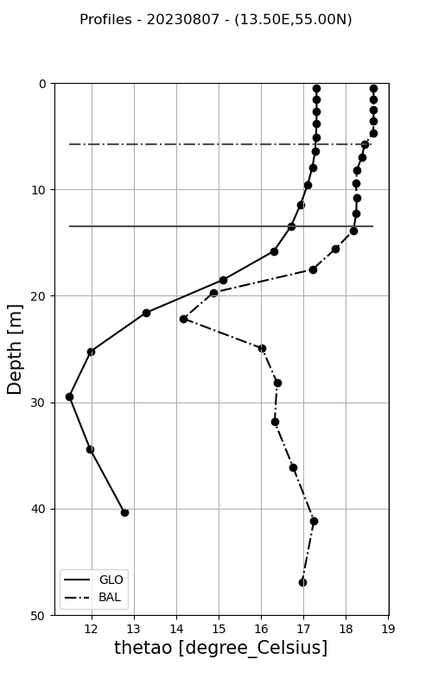
Context
Stratification
MLD = dT > 0.2 [deBoyer Montegut,2004]

Slide 21
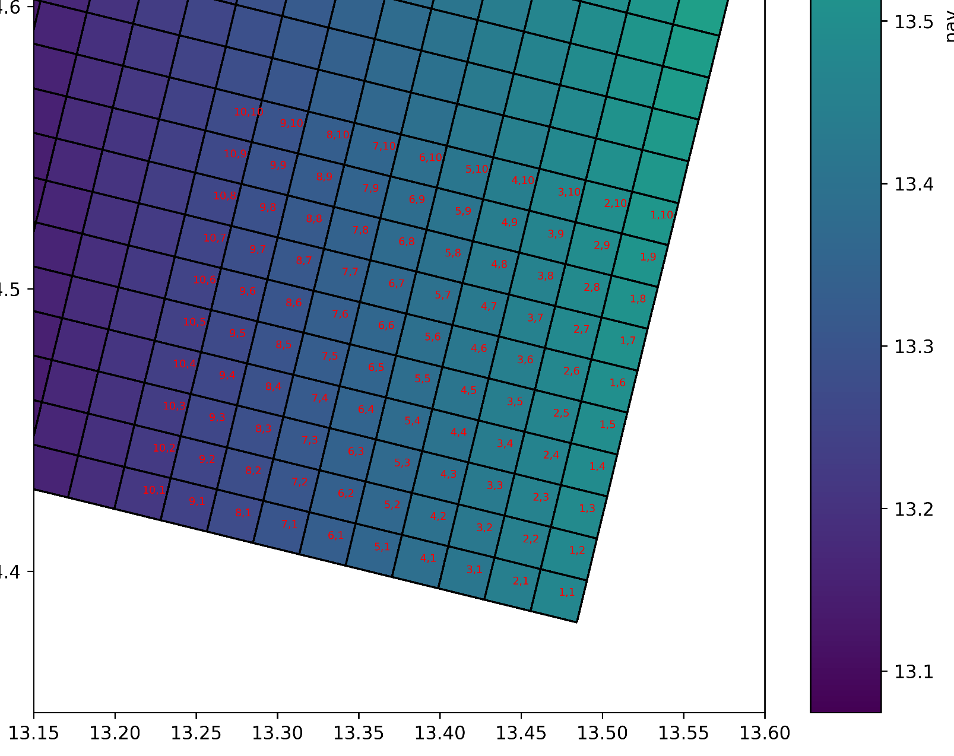
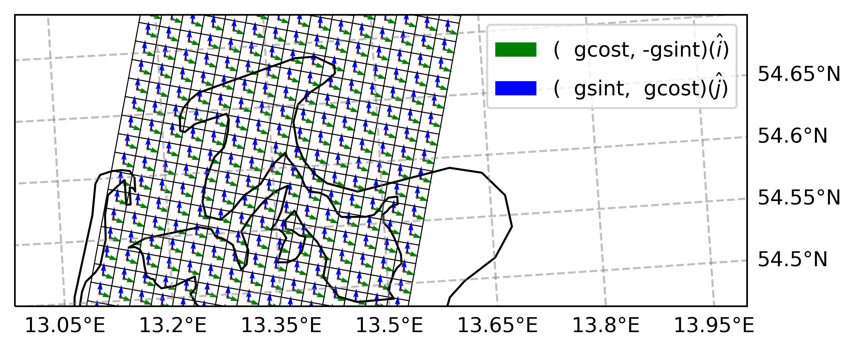
Creation of LBC Files
The creation of NEMO OBC files from CMEMS follows these steps:
Build target curvilinear grid (oriented as in NEMO fashion)
Horizontal / Vertical NaNFill in CMEMS dataset
Horizontal interpolation
Vertical interpolation
Projection of velocity in geographical frame onto (i,j) NEMO mesh framework
Rename dimensions / variables as in NEMO OBC files

Slide 22
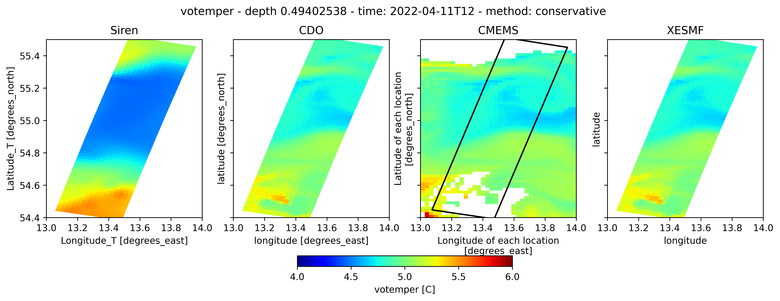
Plots
Maps

Slide 23
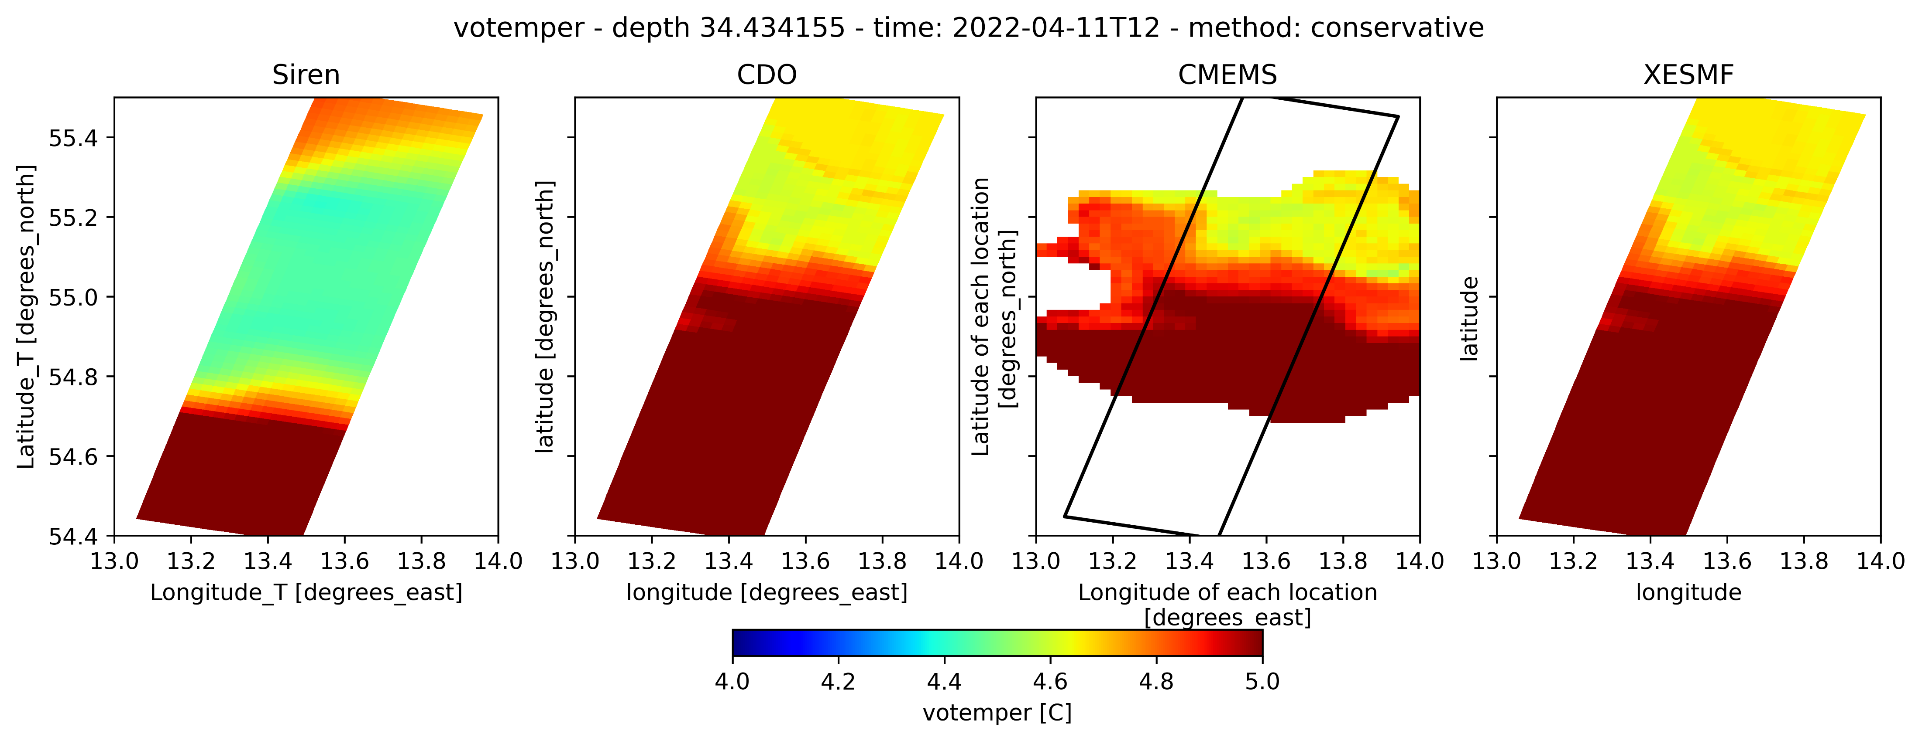
Plots
Maps

Slide 24
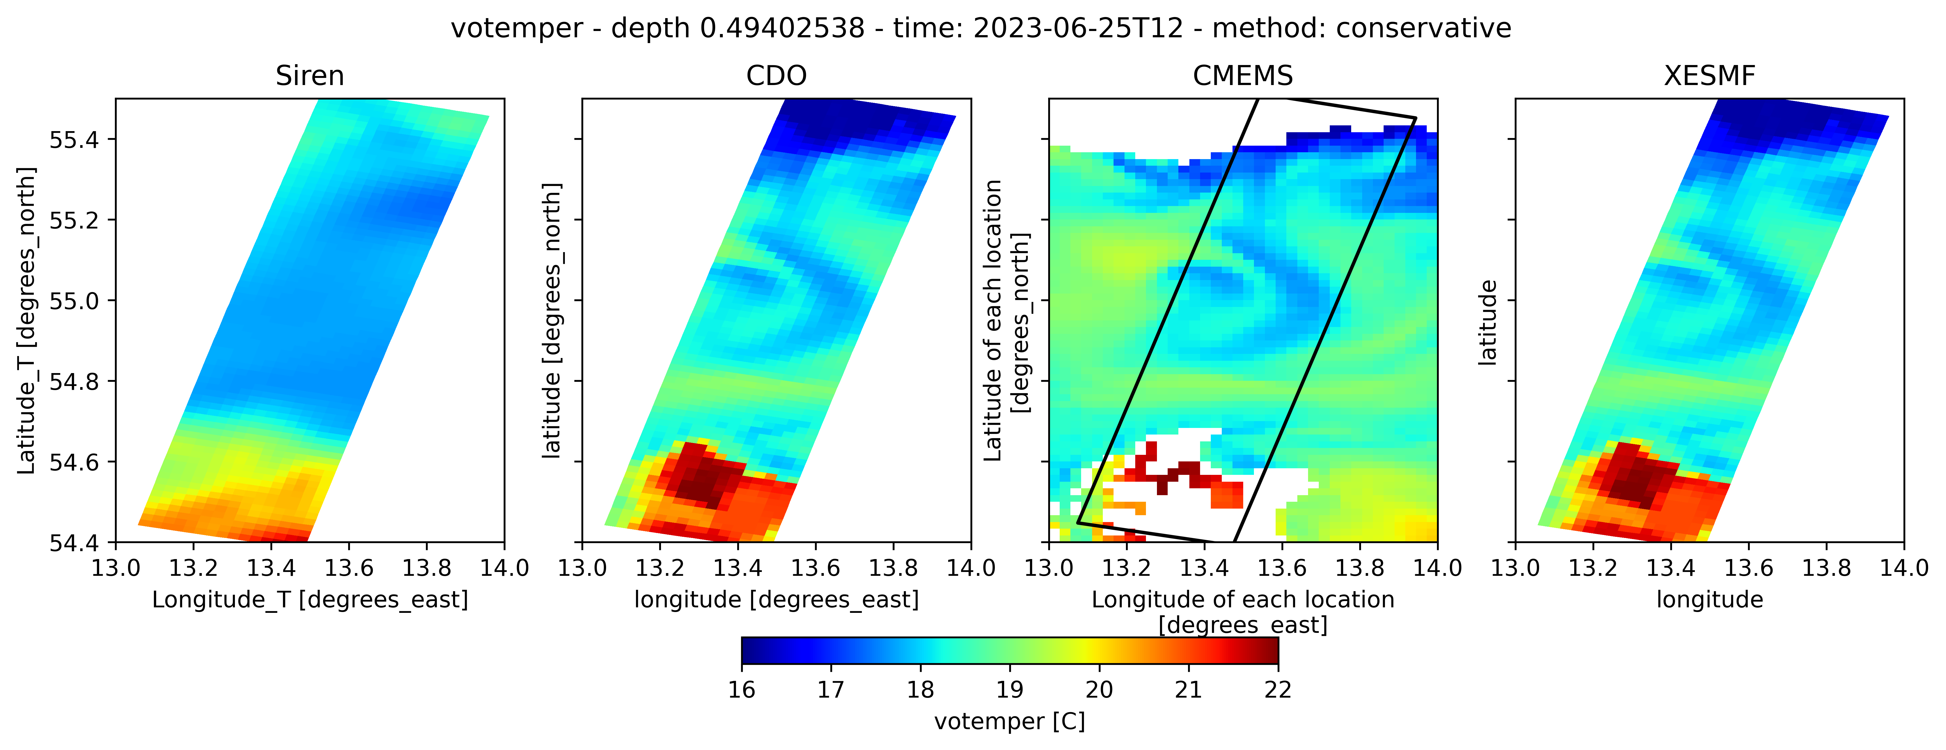
Plots
Maps

Slide 25
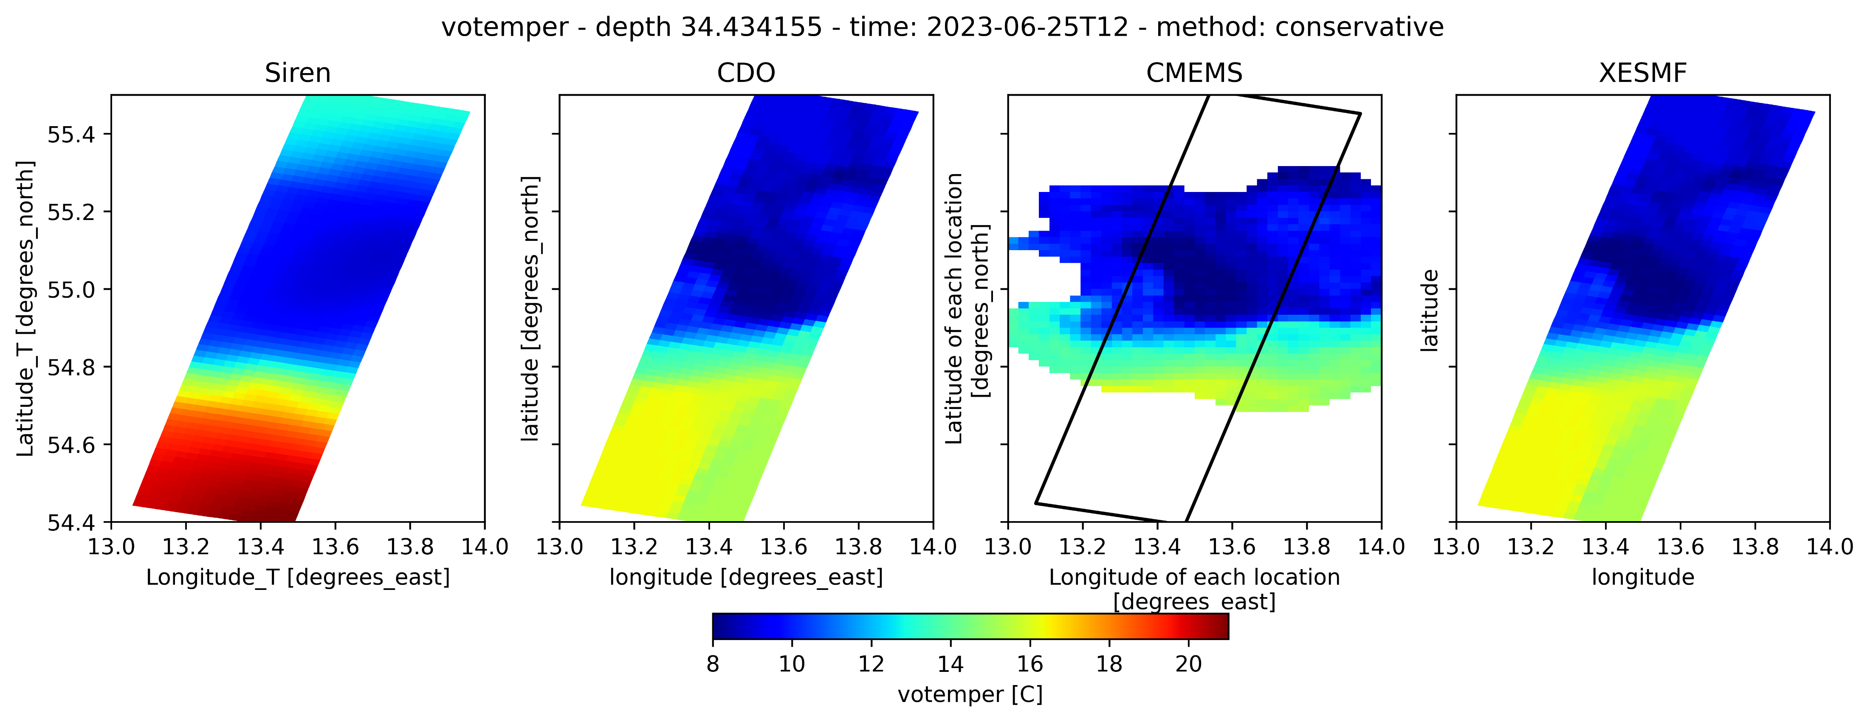
Plots
Maps

Slide 26
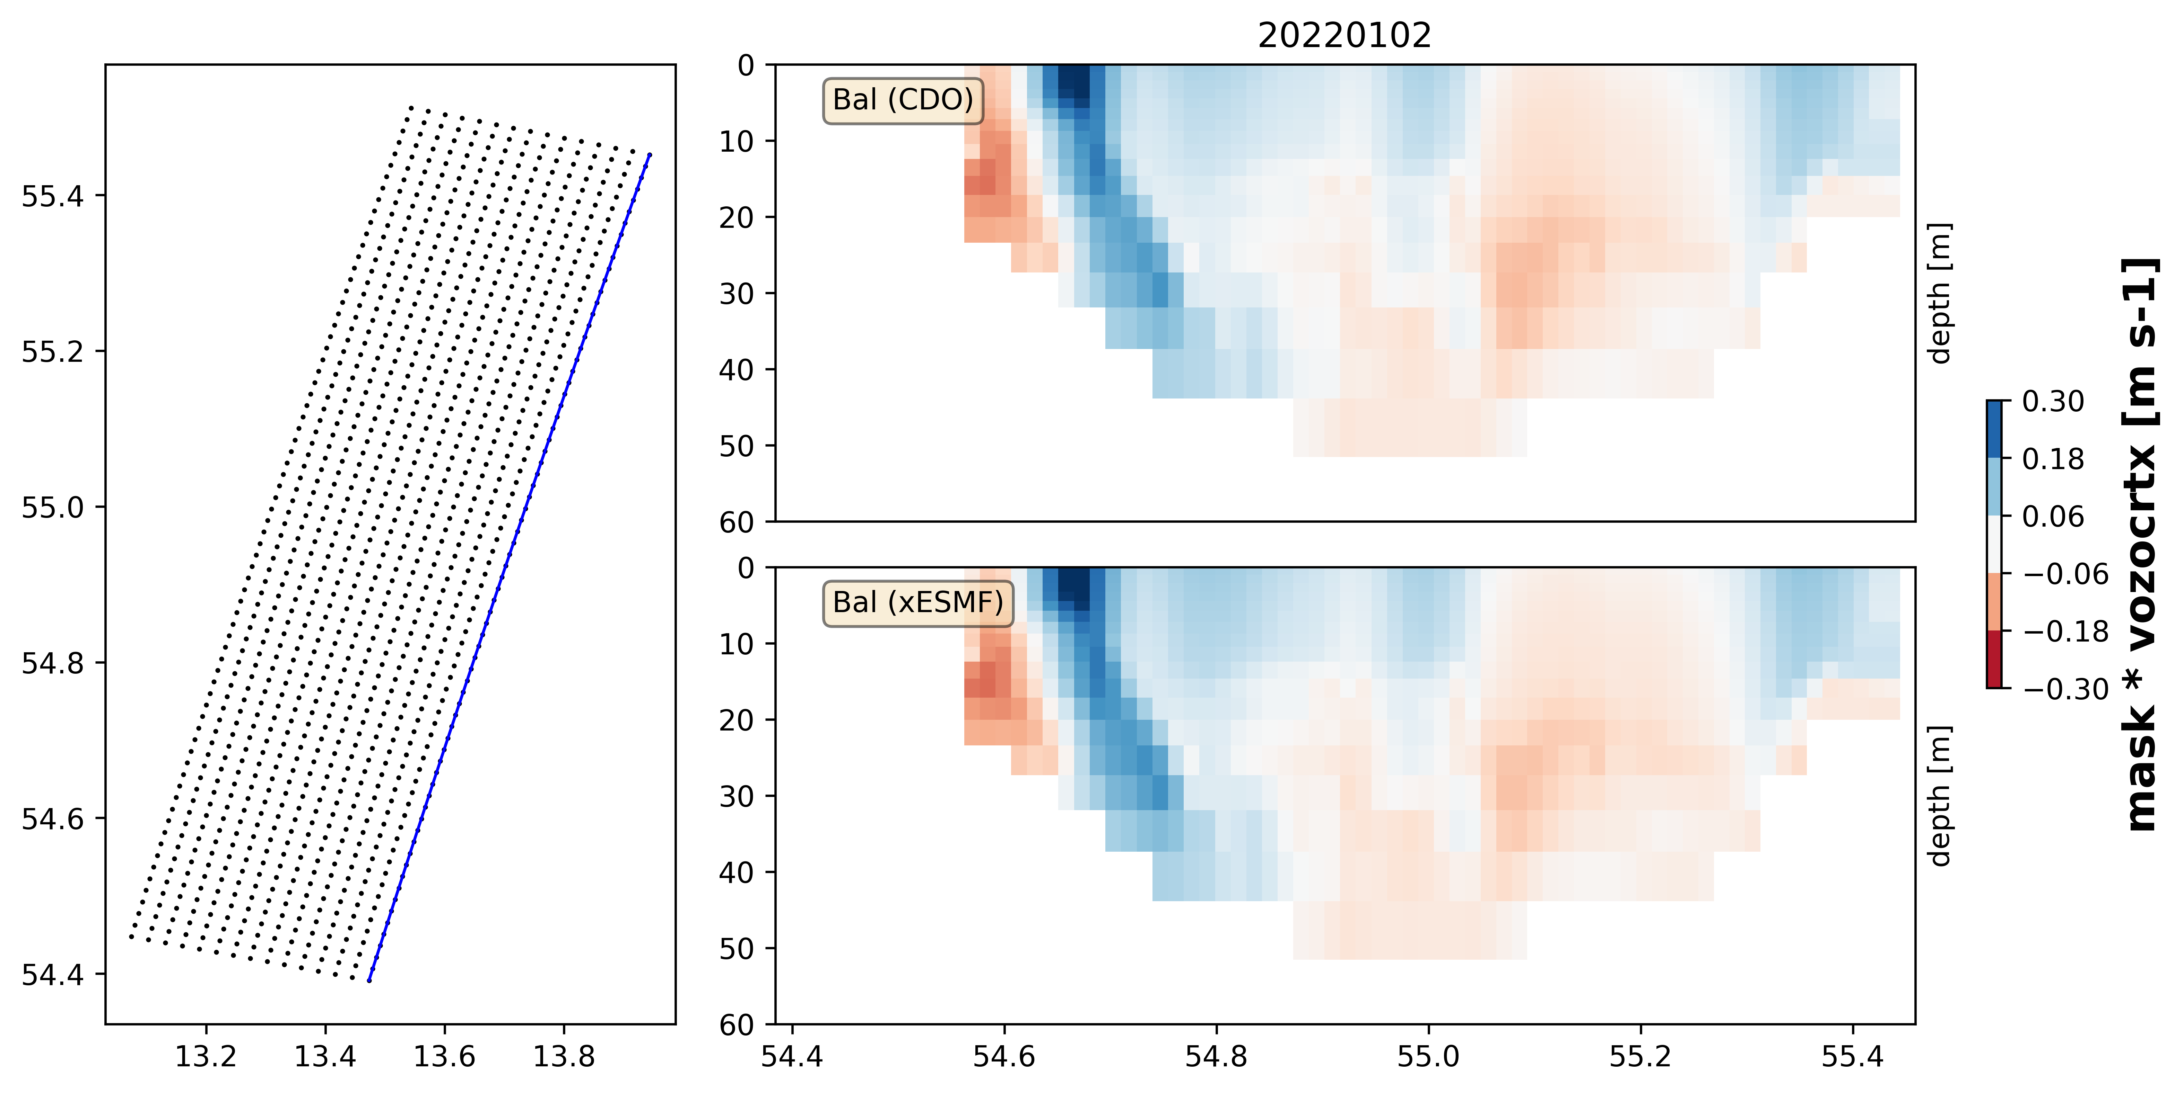
Plots
Transects

Slide 27
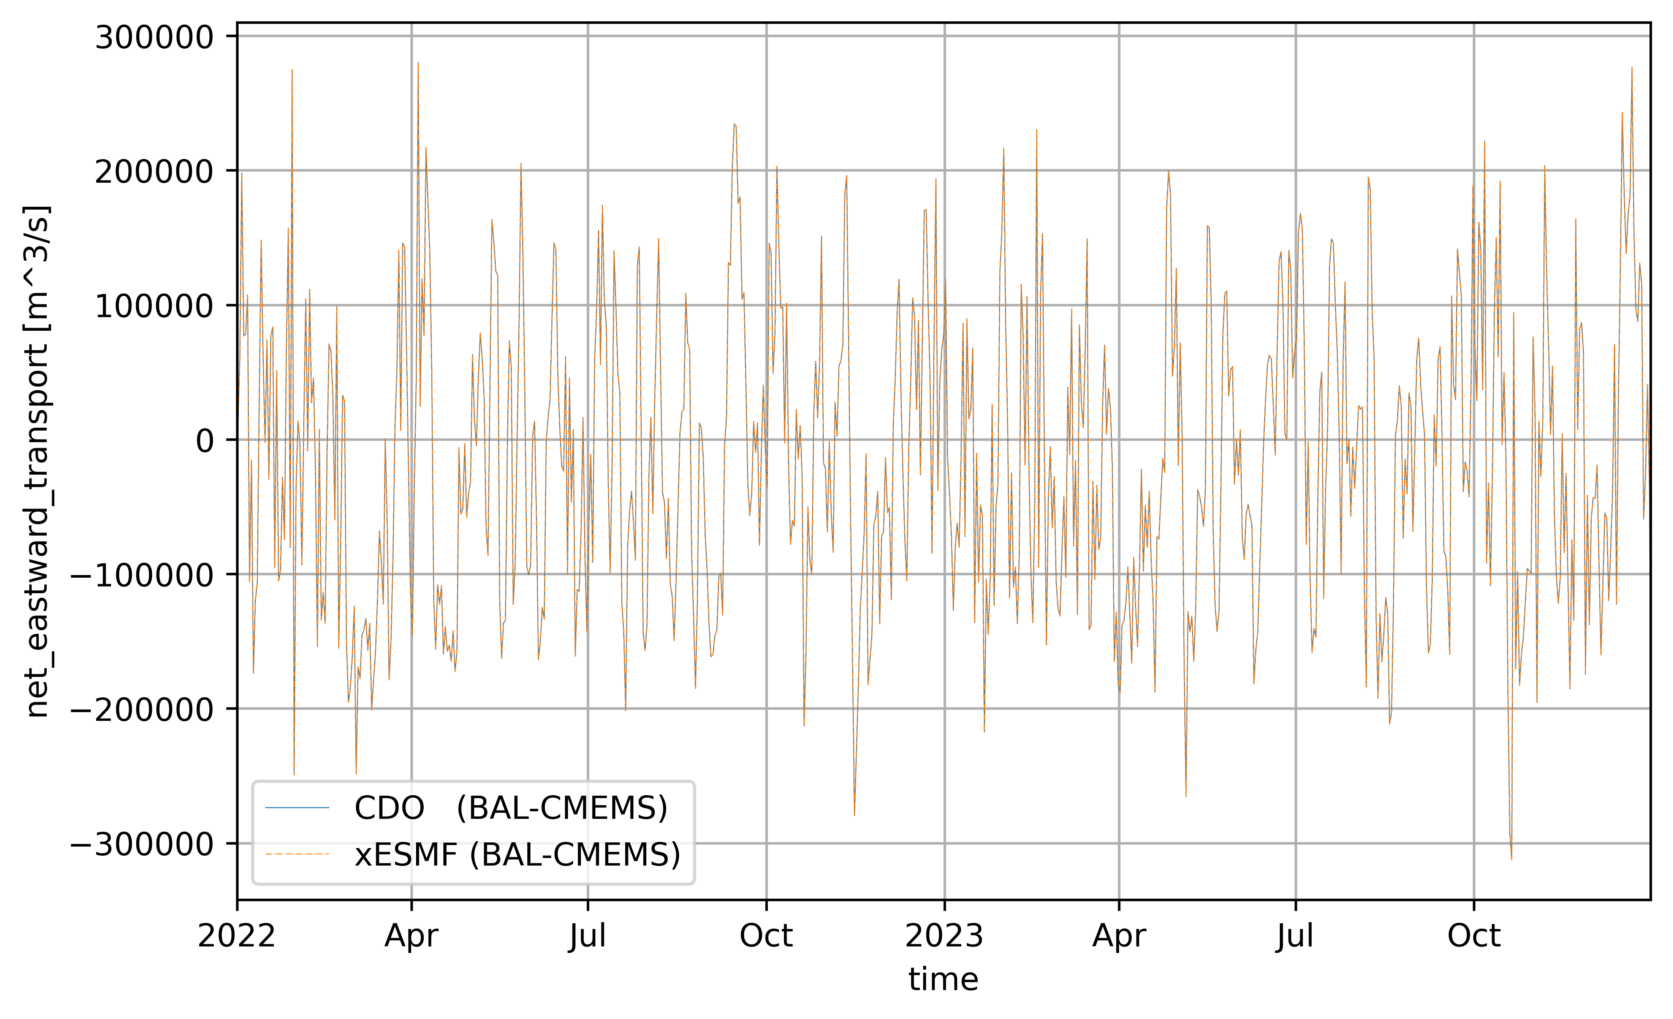
Plots
Transports

Slide 28
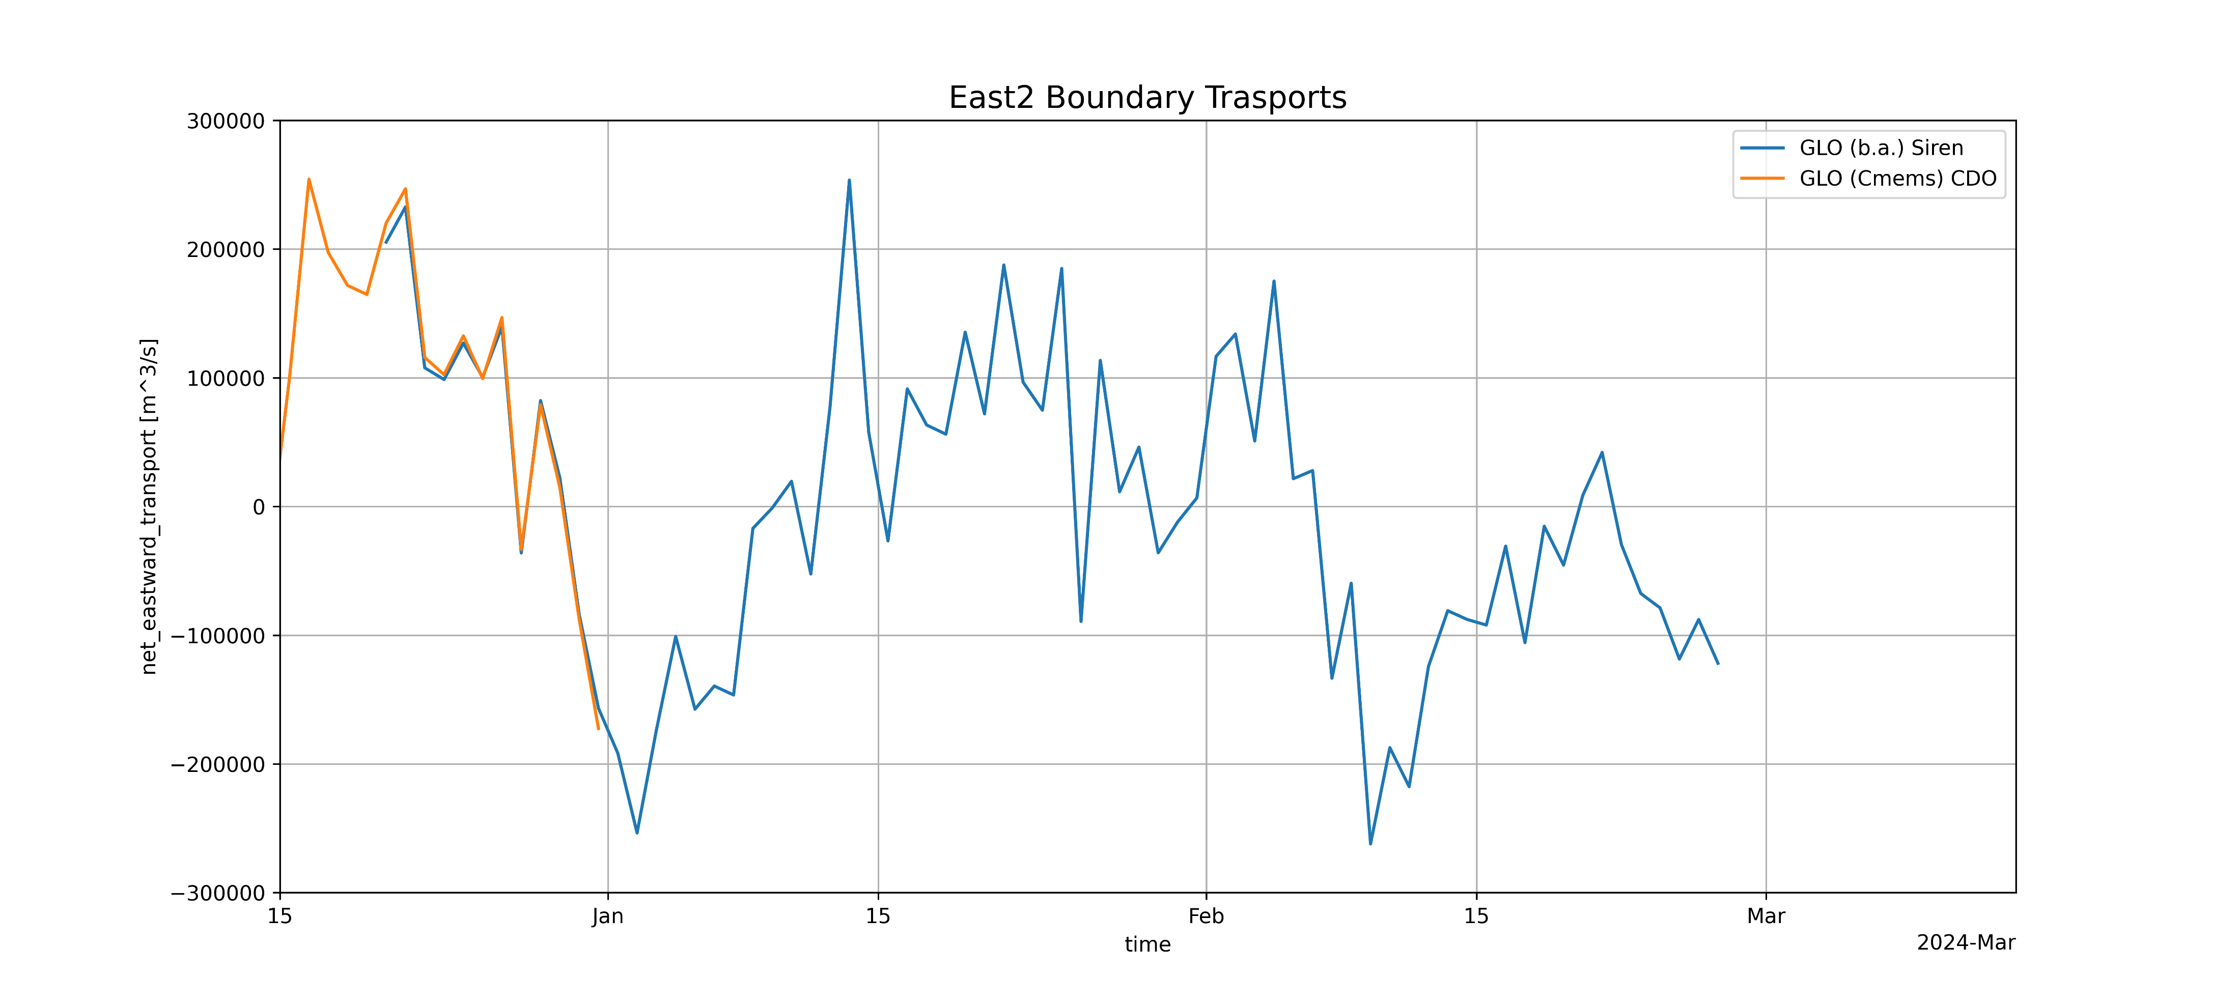
Plots
Transports

Slide 29
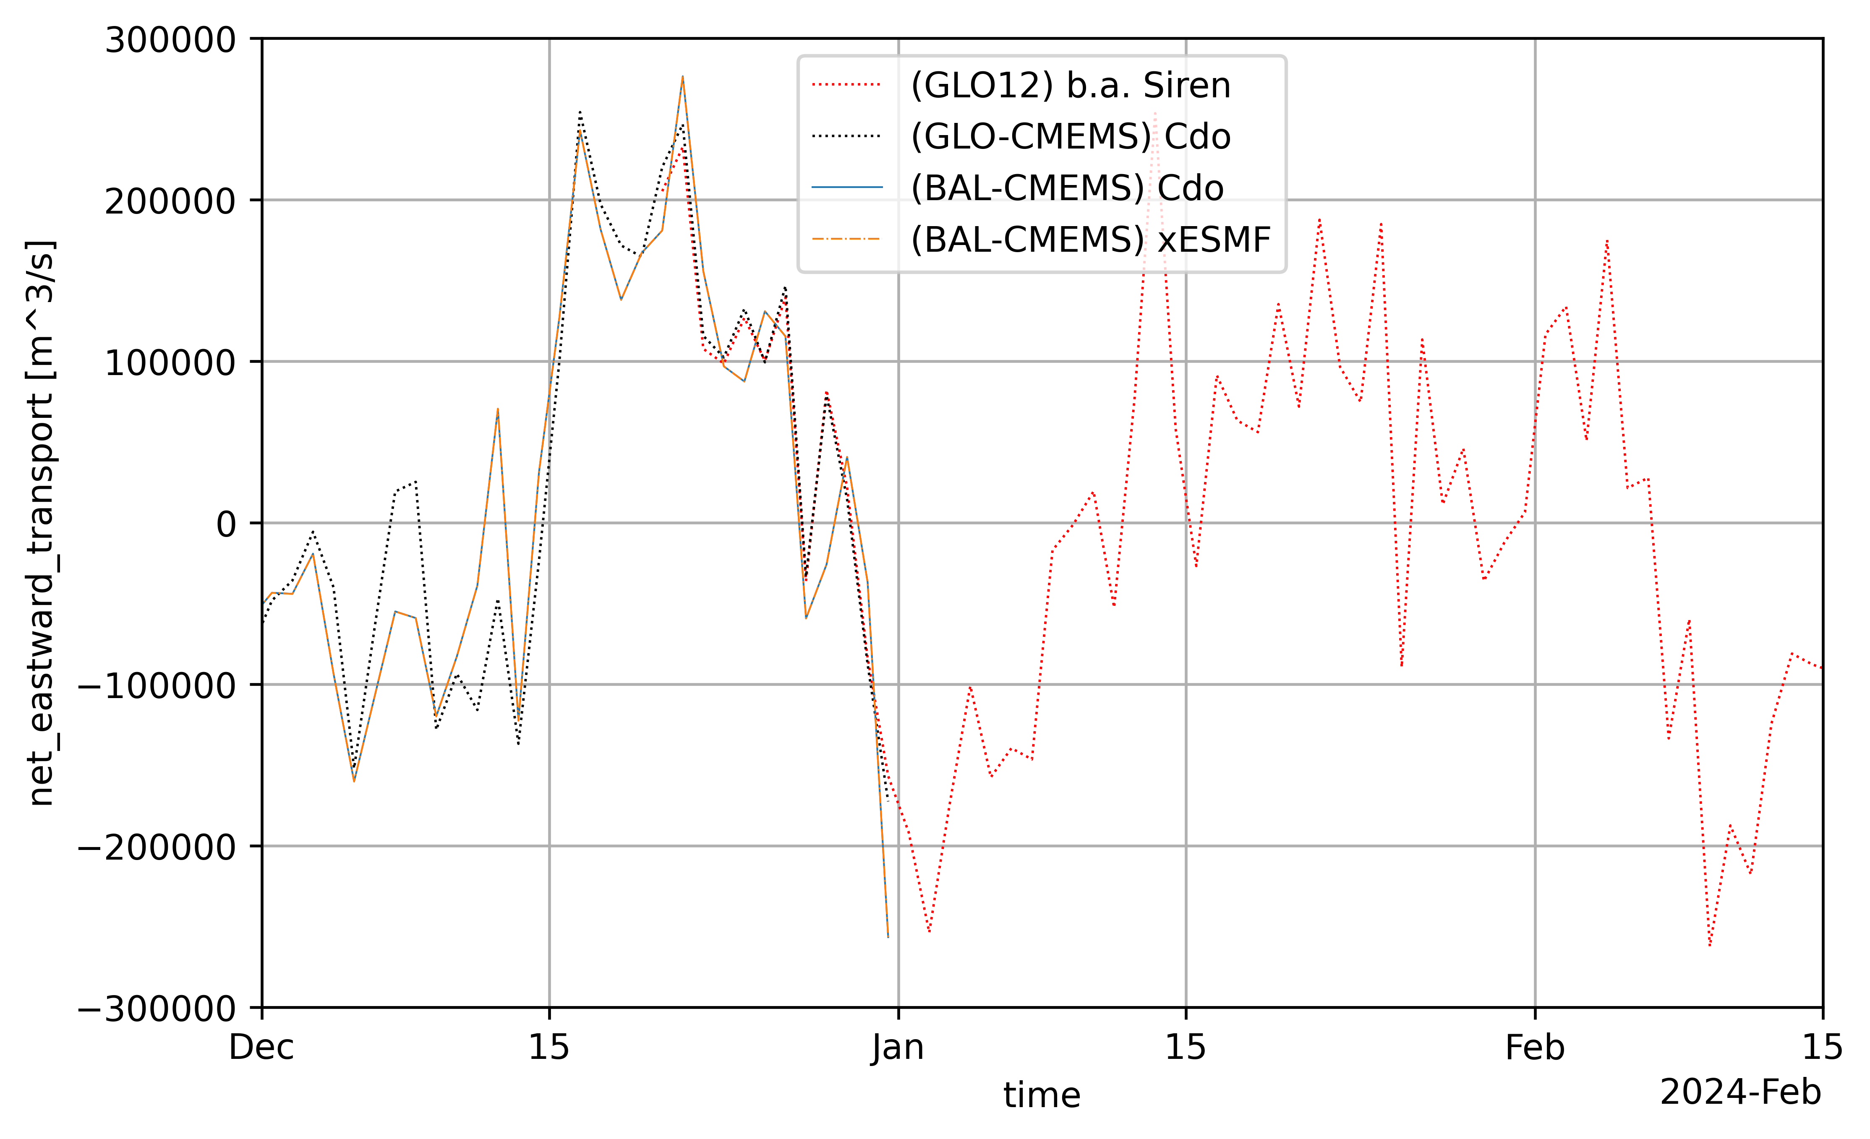
Plots
Transports

Slide 30
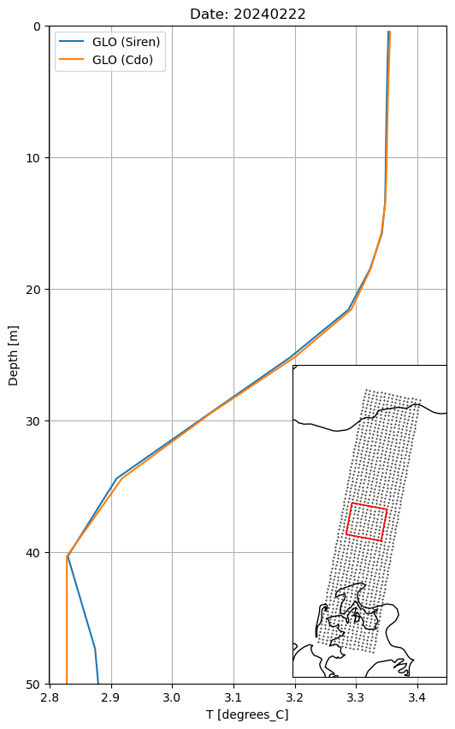
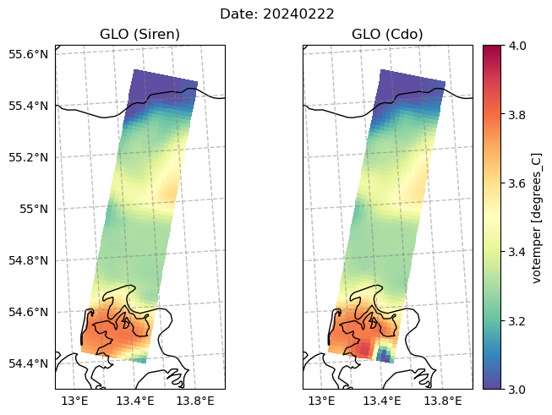
Siren (native GLO) vs Cdo (Cmems GLO)

Slide 31
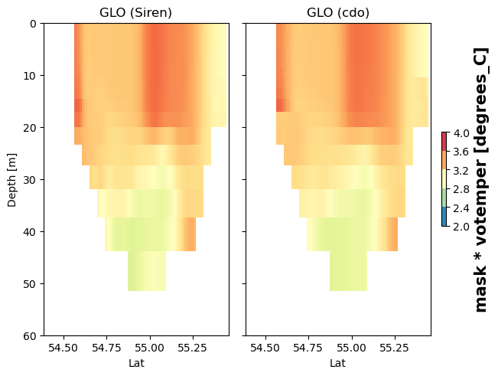
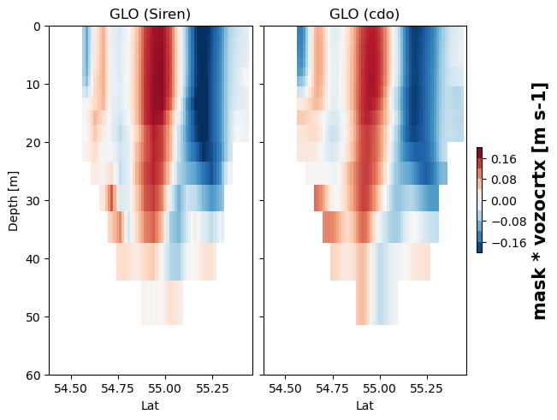
Siren (native GLO) vs Cdo (Cmems GLO)

Slide 32
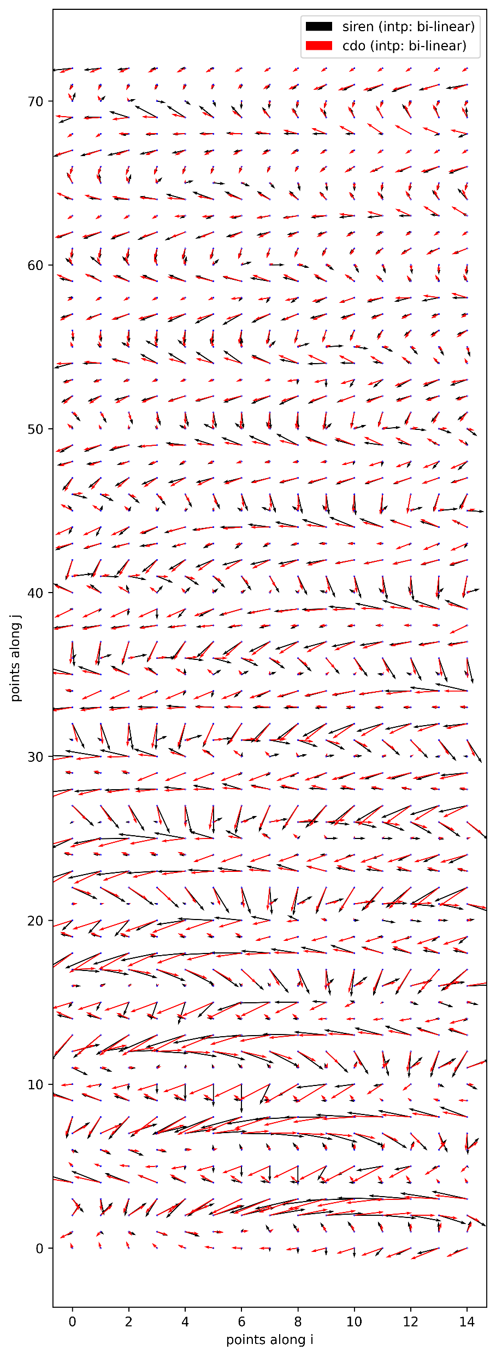
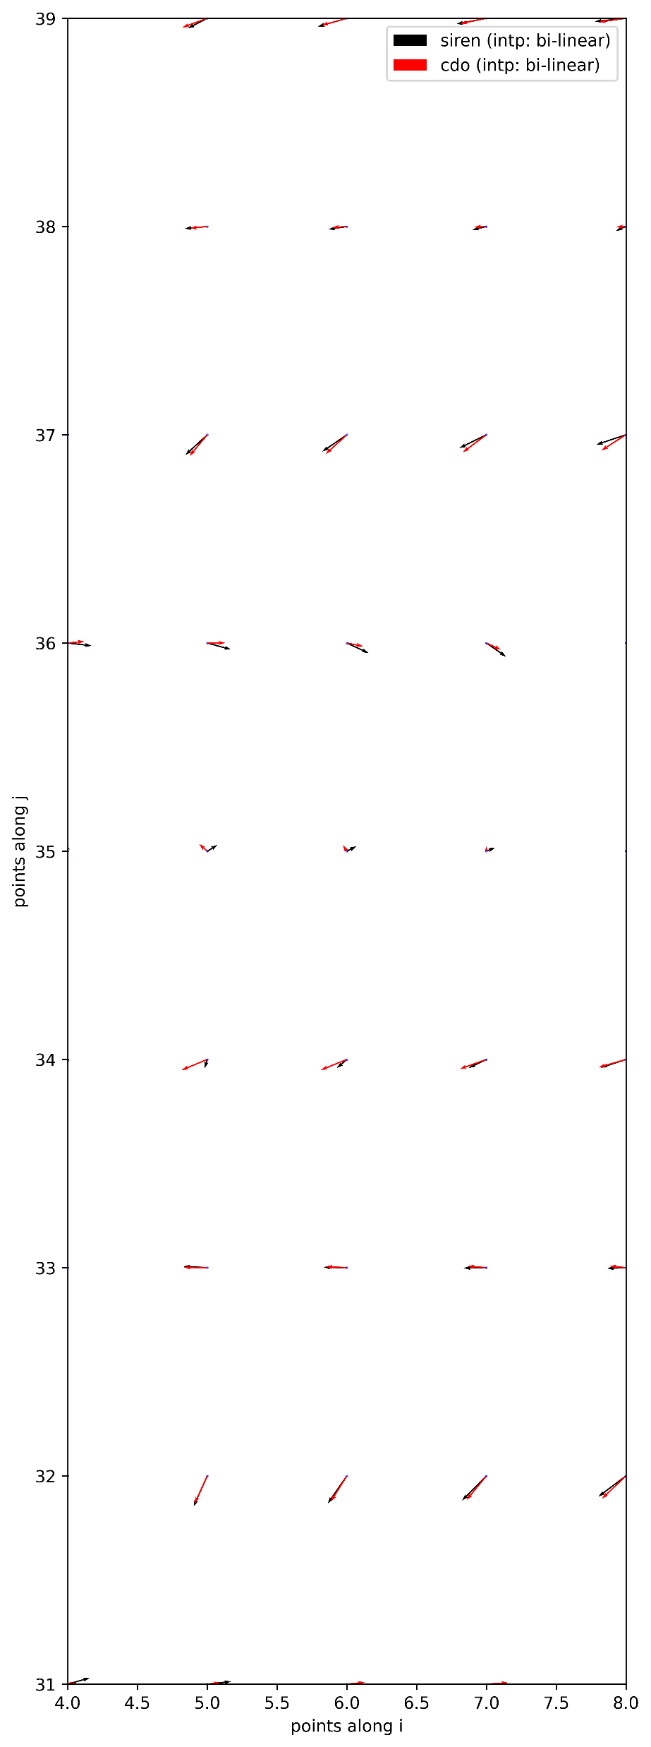
Siren (native GLO) vs Cdo (Cmems GLO)

Slide 33
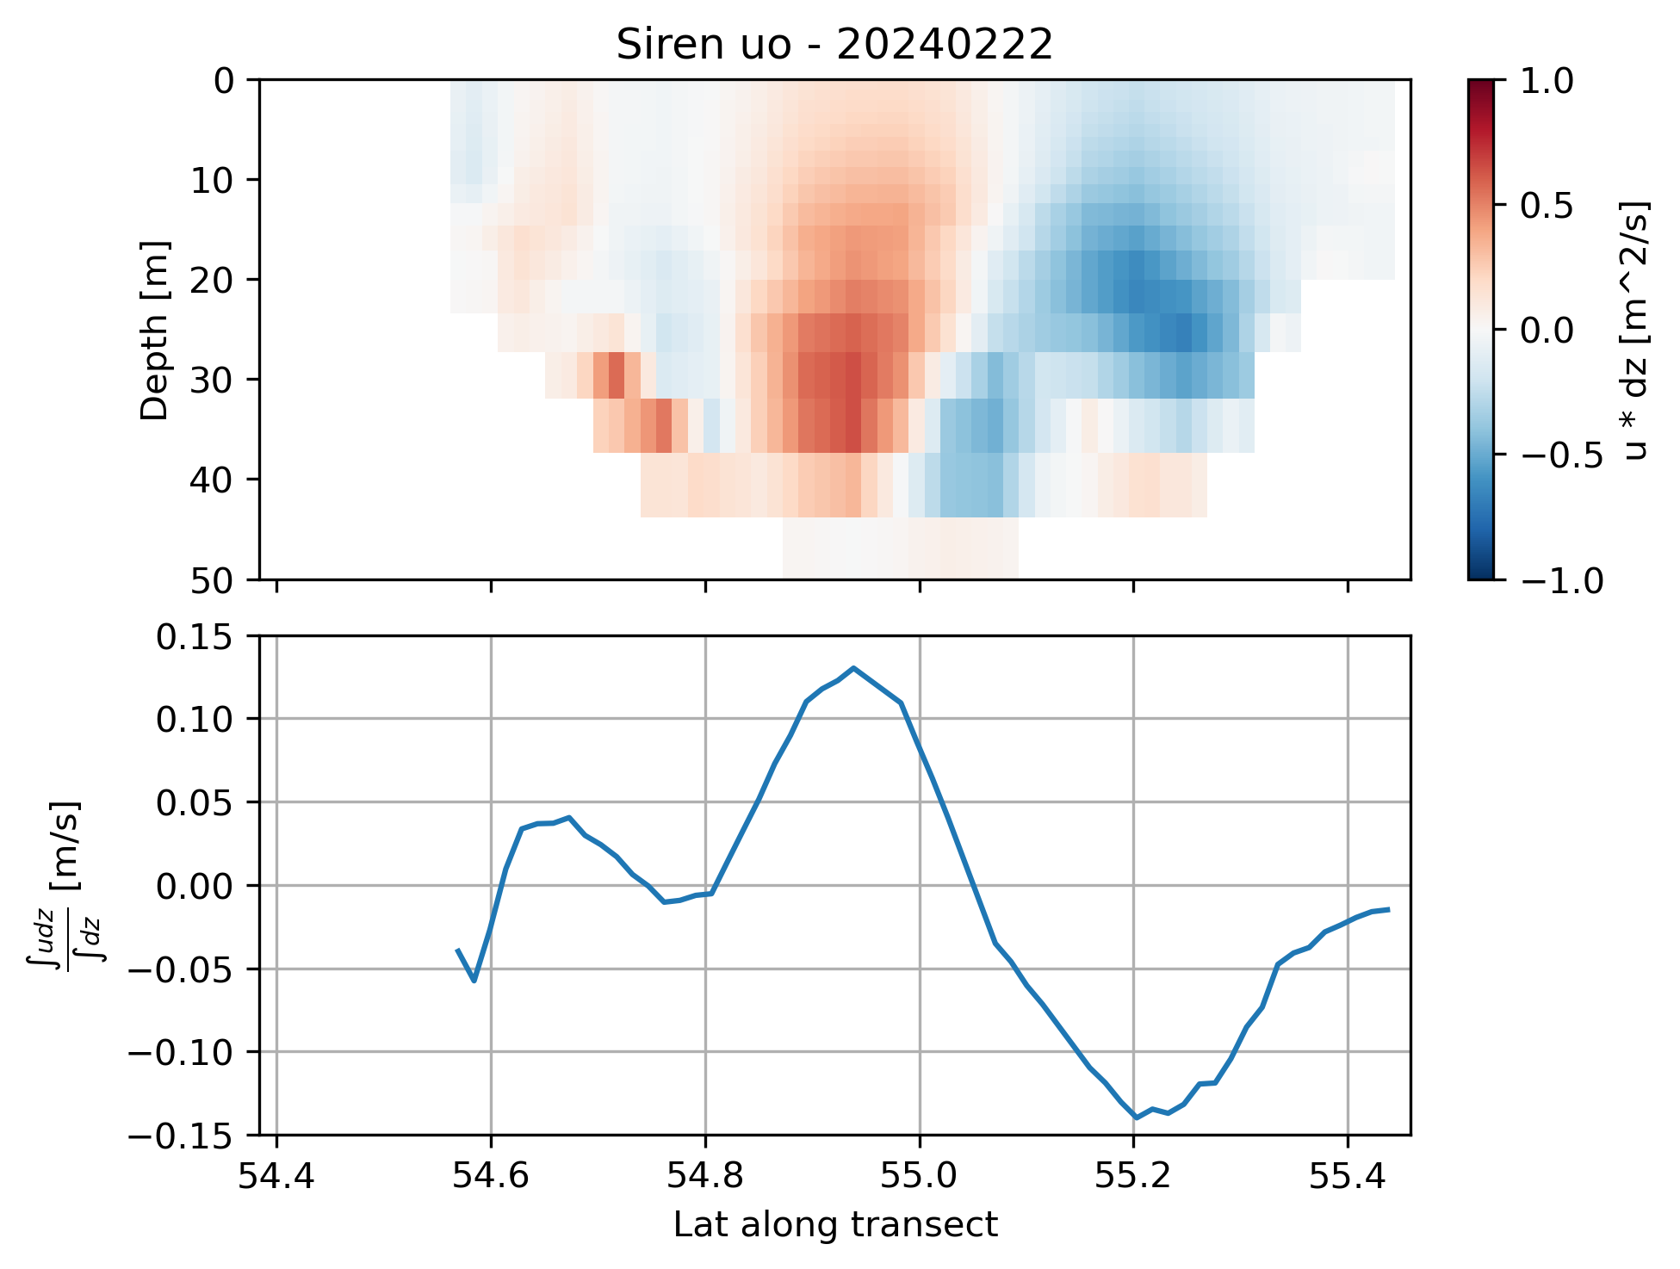

Slide 34
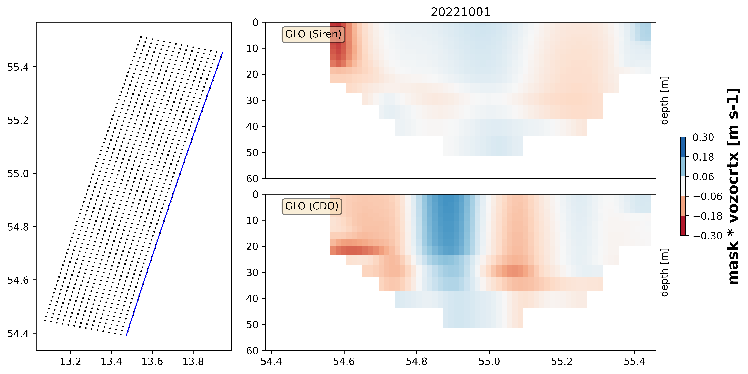
Plots
Transects
WHY SO MUCH DIFFERENCE??

Slide 35
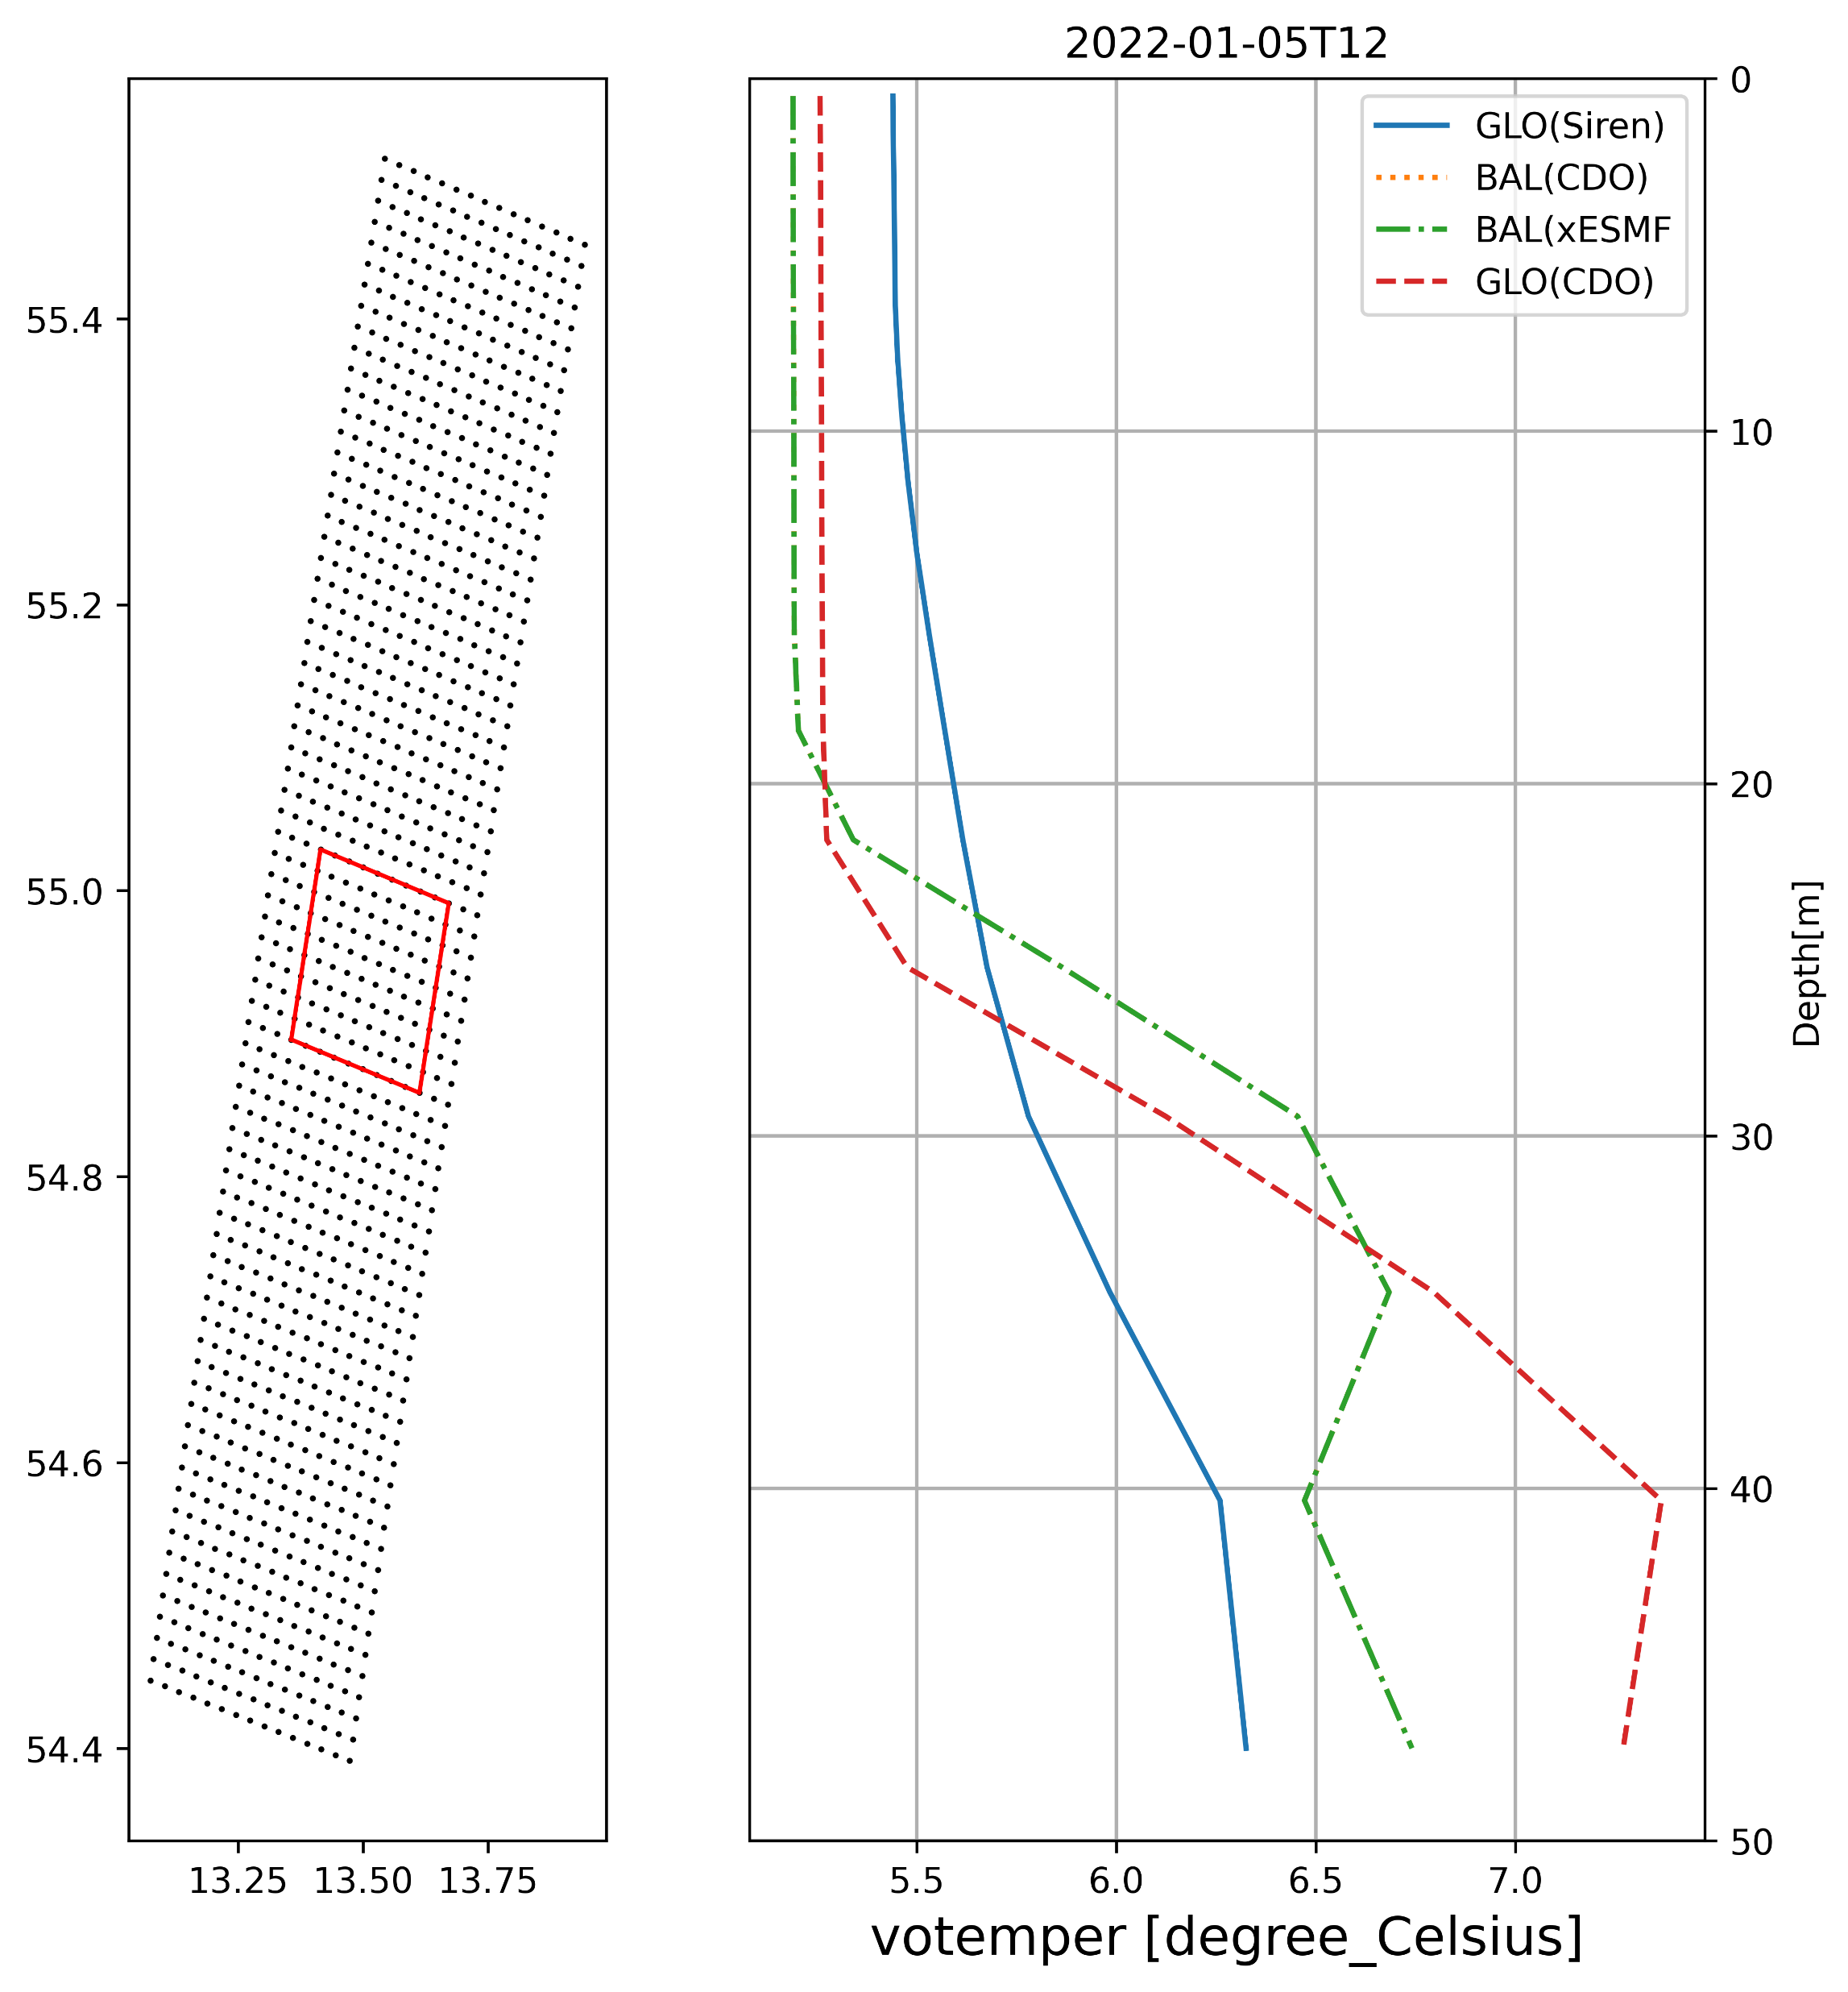
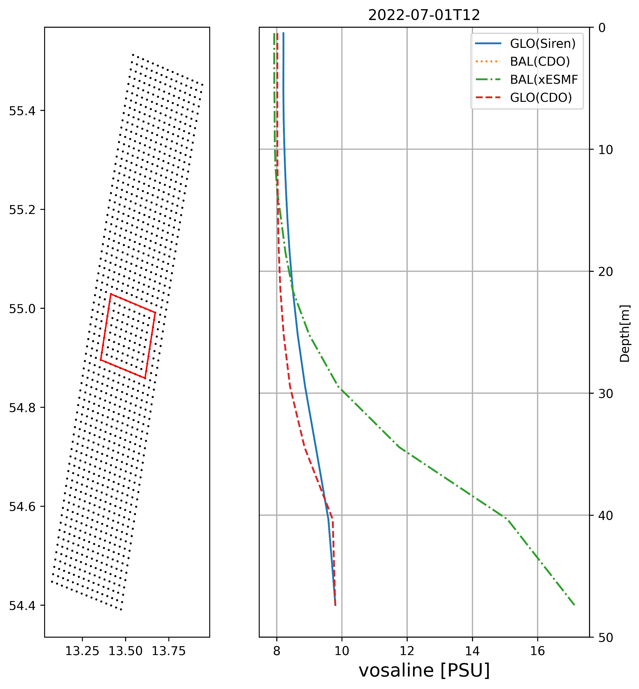
Plots
Box Averaged Profiles

Slide 37
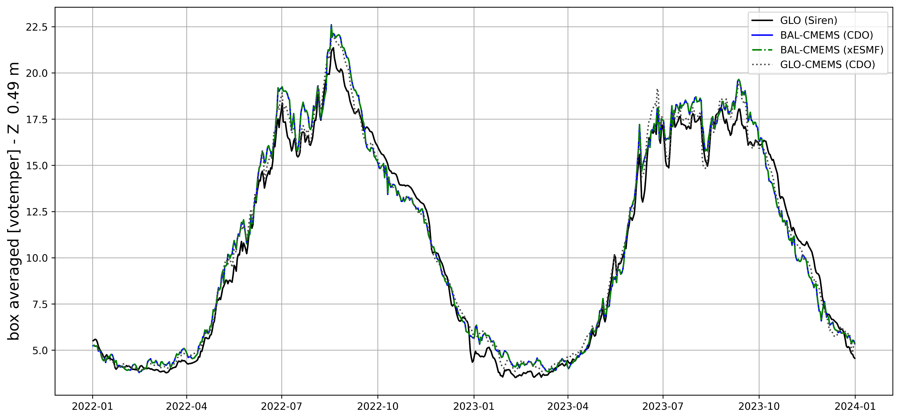
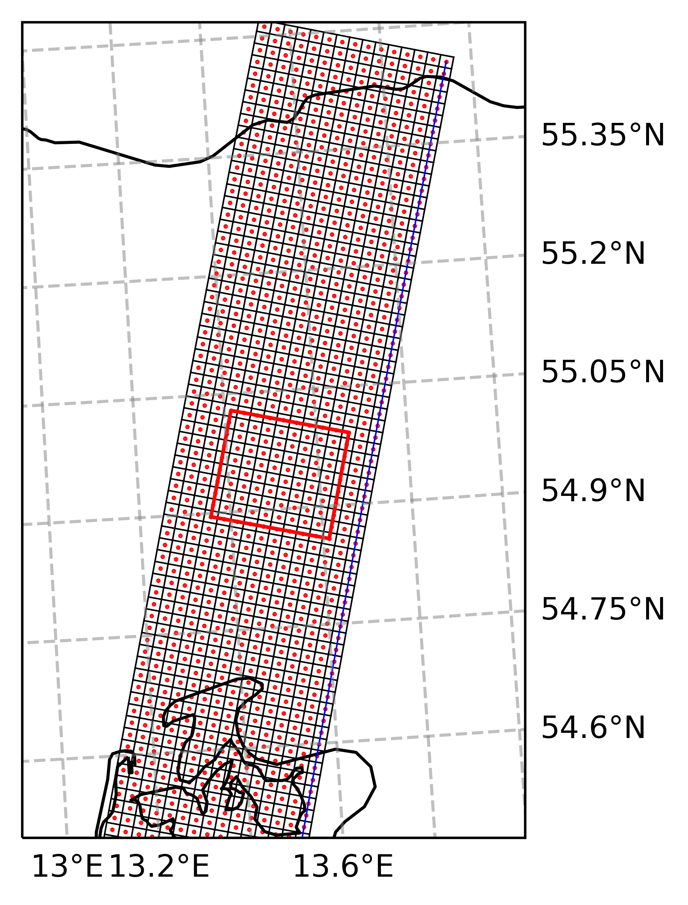
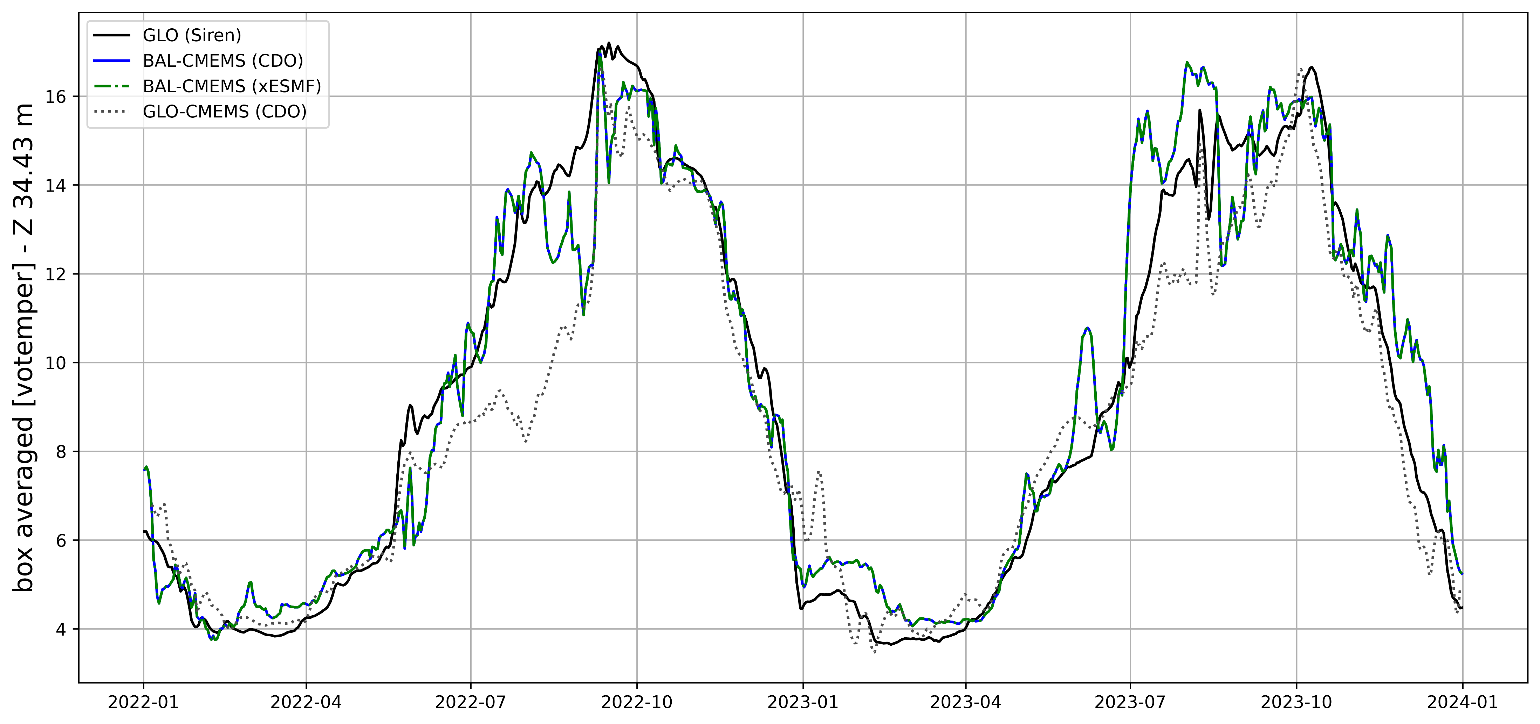
Plots
Timeseries

Slide 38
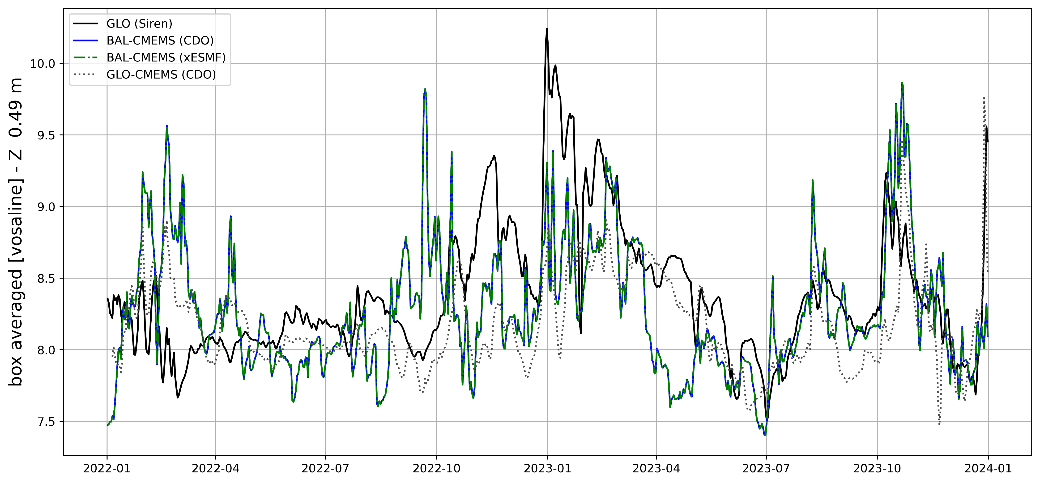

Plots
Timeseries

Slide 39

Comparison Siren / CMEMS GLO anfc

Slide 40

Comparison Siren / CMEMS GLO anfc

Slide 41










NP
Vectors in stereographic projection*
$$v_{1}$$
$$v_{1}=(zxnpt,zynpt)$$
Vector pointing to North Pole
$$v_{2}=(zxvvt,zyvvt)$$
Vector connecting V points in T cell
V
$$\hat{j}$$
α
$$\cos{α=}\frac{v_{1}⋅v_{2}}{|v_{1}||v_{2}|}$$
$$v_{2}$$
T
$$\sin{α=\frac{{( v}_{1}×v_{2})⋅\hat{k}}{\left|v_{1}\right||v_{2}|}}$$
V
$$\hat{i}$$
$$\hat{i}=(cosα,−sinα)$$
$$\hat{j}=(sinα ,cosα)$$
* Stereographic projection is conformal (angles are preserved)

Slide 42



NP
Projection of Velocity from geographical to NEMO (i,j)
$$v_{1}$$
V
$$\hat{i}=(cosα,−sinα)$$
$$\hat{j}$$
α
$$\hat{j}=(sinα ,cosα)$$
$$v_{2}$$
$$\left[\begin{matrix} & u_{p} \\ & v_{p}\end{matrix}\right]=\left[\begin{matrix}\hat{i}(0) & \hat{i}(1) \\ \hat{j}(0) & \hat{j}(1)\end{matrix}\right]⋅\left[\begin{matrix} & u_{g} \\ & v_{g}\end{matrix}\right]$$
T
V
$$\hat{i}$$

